Slide 1
Understanding APA Citation Styles
North South University Library
Thursday, 30 October 2025

Slide 2
What is a Style Guide?
A style guide is a set of rules and conventions for writing, formatting, and citing sources in academic and professional work.
Common style guides include APA, MLA, Chicago, and IEEE

Slide 3
Why Do We Use Them?
Consistency: Ensures uniformity in formatting and citation across academic papers.
Clarity: Helps writers present their research in a structured and readable manner.
Credibility: Demonstrates professionalism and adherence to scholarly standards.
Avoiding Plagiarism: Ensures proper attribution of sources.

Slide 4
How Do We Use Them?
Follow formatting rules for margins, fonts, headings, spacing etc.
Use in-text citations correctly when paraphrasing or quoting sources.
Create a properly formatted reference list at the end of the paper.

Slide 5
APA for Student Papers
Rules for font sizes are more lenient.
a sans serif font such as 11-point Calibri, 11-point Arial, or 10-point Lucida Sans Unicode or a serif font such as 12-point Times New Roman, 11-point Georgia

Slide 6
Title Page Format
Running head (optional)
Title (bold)
Author byline
Affiliation
Due Date

Slide 7
Title Page (headers)
New changes for 7th edition for Title Page:
  Running head is no longer required unless professor requires one. If professor requires a header, then the following information is needed:
    Include a running head fewer than 50 characters and are left aligned; capitalize every letter
    The words “Running head:” no longer appear as a label on the first page
    Page numbers are still right aligned, with title page as number 1

Slide 8
Title Page (title information)
New changes for 7th edition for Title Page:
  Titles are placed in the upper 2/3rds of the title page in bold print, center aligned.
  All words should be capitalized except the following: articles (a, an, the);conjunctions (so, but, nor, and, or, yet, for); prepositions that are three letters or fewer ( examples: on, in, for, at, by, of)
  Titles are normally 12 words or fewer
  If colons are included in titles, the first letter of the first word should be capitalized
  Lines should be double spaced

Slide 9
Title Page (author information)
  Below the title, type the author byline: first name, middle initial (if applicable), and last name
  If there is more than one author, then list the authors’ names in order of their contribution (or alphabetical order), and separate names with a comma. Use “and” before the last name.
  Example: Whitney Post, Sam Ruitz, and Matt Henson
  or
  Matt Henson, Whitney Post, and Sam Ruitz

Slide 10
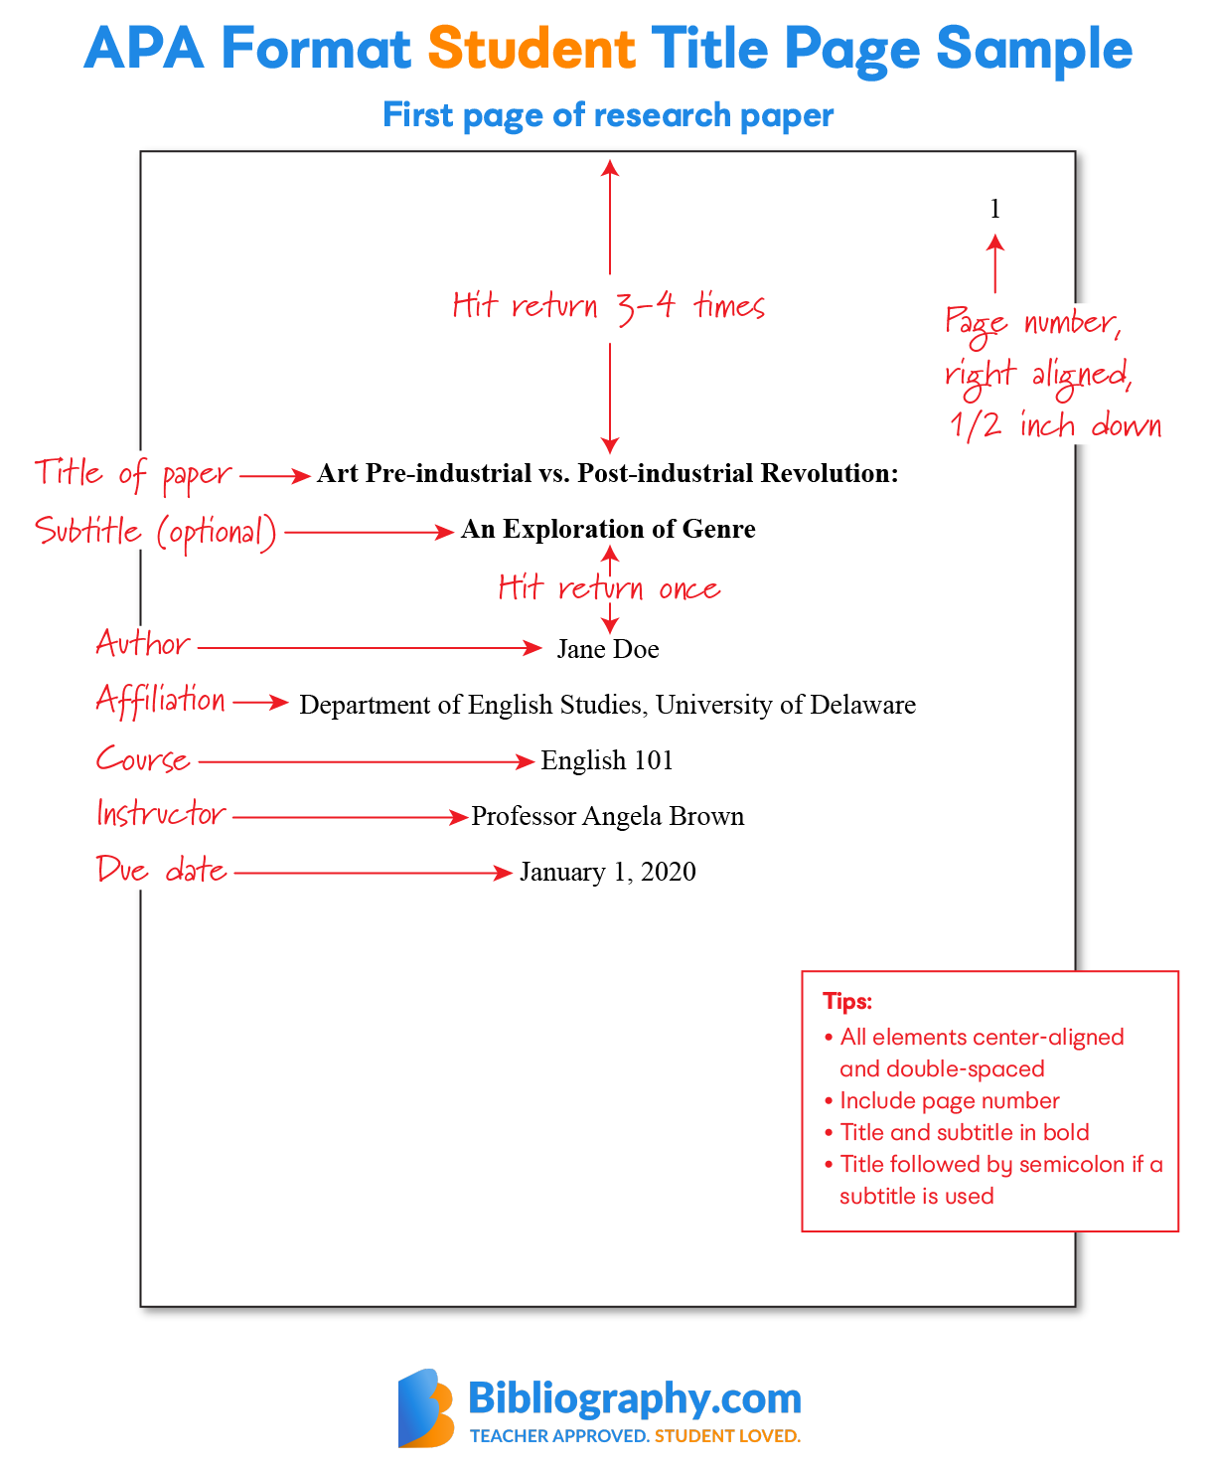
Sample Title Page

Slide 11
Headings

Slide 12
Level Headings
Level | Format
1 | Centered, Bold, Title Case Heading Text begins as a new paragraph.
2 | Flush Left, Bold, Title Case Heading Text begins as a new paragraph.
3 | Flush Left, Bold Italic, Title Case Heading Text begins as a new paragraph.
4 | Indented, Bold, Title Case Heading, Ending With a Period. Text begins on the same line and continues as a regular paragraph.
5 | Indented, Bold Italic, Title Case Heading, Ending With a Period. Text begins on the same line and continues as a regular paragraph.
APA (2020)

Slide 13
Summarizing, Paraphrasing, and Quoting

Slide 14
Summarizing
When you summarize, you put the main idea(s) into your own words, including only the main point(s).
  Summarized ideas must be attributed to the original source.
  Summaries are significantly shorter than the original.
  Summaries take a broad overview of source material.
Notes:
(Show title) Here is what you do when you summarize
(read arrow 1)
Now here are some summary characteristics
(show and read each bullet)
Note that when you attribute to an original source, you must refer to at least the author and year in the signal phrase, which we will discuss shortly.
In a summary, you are condensing multiple paragraphs or pages down to just a few sentences, or maybe a single paragraph.

Slide 15
Summarizing
(continued)
Summarize any ideas or text that you believe are important. Proper summarization should condense the main idea or text of several pages (or even the entire source!) into a brief overview.
By summarizing you save many paragraphs or pages of unnecessary text. When using in-text citations for summaries, you must always cite the author and publication year.
Summaries do not require page numbers; this is because the text summarized will usually cover several pages of text.
EX: Studies show that throughout colleges and universities teachers are often hired from one area of study to teach a different area of study (Carpini, 2004; Wilson, 1998).

Slide 16
Paraphrasing
Paraphrasing involves putting a passage from source material into your own words.
  Attribute paraphrases to their original sources.
  Paraphrases are usually shorter than, but may be the same length as the original passage.
  Paraphrases take a more focused segment of the source and condense it slightly.
EX: Lortie’s (1975) research reveals that classroom experiences as well as interactions among peers and colleagues contribute to teacher learning (p. 79).
Notes:
(Show title) Here is what you do when you paraphrase
(read arrow 1)
Now here are some paraphrase characteristics
(show and read each bullet)
In the summary, you took much larger segments of text that explained main concepts and core ideas and reduced them to a few sentences or a paragraph. In a paraphrase, you take any segment of the text, usually a single, more focused idea, and put it entirely into your own words. It is not uncommon for a paraphrase to remain about the same length as the original idea, although again, the expression of the idea must be entirely in your own words.
Remember, if you shrink a paraphrase too much, then you’ll be summarizing.
If you use the author’s words, you’ll actually be quoting.

Slide 17
Quoting
Quotations must be identical to the original.
  Quotations use a narrow segment of the source.
  They must match the source document word for word and must be attributed to the original author.
  Use quotes when the actual words are so integral to the discussion that they cannot be replaced.
  Use quotes when the author’s words are so precisely and accurately stated that they cannot be paraphrased.
EX: Stenberg and Lee (2002) agree that teacher learning is an “intellectual and ongoing process” (p. 327).
Notes:
(Show title) Here is what you do when you quote a text
(read arrow 1)
You are not allowed to change anything in the quote without some identifying mark, usually brackets. Changing even a few letters is considered a form of plagiarism by many people.
(show and read each bullet)
Remember that you do not simply add in a quote (or a paraphrase or summary, for that matter) without creating a transition for your reader. You need to use a signal phrase to show readers that you are moving from your own ideas into someone else’s. Signal phrases also give you the opportunity to discuss how your argument is connected to the source you are integrating. Since signal phrases are so important, let’s turn to them next.

Slide 18
Quoting
(continued)
Short Quotations (under 40 words):
Incorporate the quote into the text and enclose it in double quotation marks (" ").
Include the author, year, and page number in parentheses immediately following the quote.
Example: Smith (2020) argued that "This is a short quote" (p. 12).
Notes:
(Show title) Here is what you do when you quote a text
(read arrow 1)
You are not allowed to change anything in the quote without some identifying mark, usually brackets. Changing even a few letters is considered a form of plagiarism by many people.
(show and read each bullet)
Remember that you do not simply add in a quote (or a paraphrase or summary, for that matter) without creating a transition for your reader. You need to use a signal phrase to show readers that you are moving from your own ideas into someone else’s. Signal phrases also give you the opportunity to discuss how your argument is connected to the source you are integrating. Since signal phrases are so important, let’s turn to them next.

Slide 19
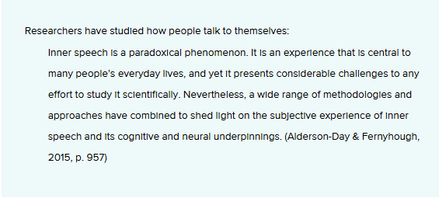
Quoting
(continued)
Block quotations (40 words or more):
Start the quotation on a new line, indented 0.5 inches from the left margin (block format).
Do not use quotation marks around the block quote.
The citation should appear in parentheses after the closing punctuation of the block quote.
Example:
Notes:
(Show title) Here is what you do when you quote a text
(read arrow 1)
You are not allowed to change anything in the quote without some identifying mark, usually brackets. Changing even a few letters is considered a form of plagiarism by many people.
(show and read each bullet)
Remember that you do not simply add in a quote (or a paraphrase or summary, for that matter) without creating a transition for your reader. You need to use a signal phrase to show readers that you are moving from your own ideas into someone else’s. Signal phrases also give you the opportunity to discuss how your argument is connected to the source you are integrating. Since signal phrases are so important, let’s turn to them next.

Slide 20
Signal Phrases and In-Text Citation
Signal phrases introduce someone else’s work – they signal that the words and ideas that are about to be offered belong to someone other than the author of the paper. According to Jones (2013), research revealed….(p.4).
In-text citations are the parenthetical pieces of information that appear usually at the end of a quote, paraphrase, or summary (though they sometimes appear before). (Jones, 2013, p. 4)
Notes:
(show title) Finally, we’ll take a look at the role signal phrases and in-text citation play in APA style.
(show 1-2, reading each)
Remember, it’s your responsibility to cue the reader as to what is your knowledge and what are your ideas as opposed to someone else’s.
(show 3)
Here’s a simple rule to follow: (read)
(repeat the rule w/underline)
Now let’s see how this works.

Slide 21
Signal Phrases and In-Text Citation (continued)
Limited signal, everything in citation
  Blah, blah, blah. . . end of paraphrased sentence, in which you convey the author's ideas in your own words (Krepp, 1985, p. 103).
  Blah, blah, blah " end of quoted sentence" (Krepp, 1985, p. 103).
Author and year in signal, page in citation
  Krepp (1985) revealed that . . . (p. 103).
  According to Krepp (1985), ". . ." (p. 103).
Notes:
(show title)
(show 1) In this example, author, year, and page appear in the in-text, or parenthetical citation that comes after the paraphrase or quote. Notice that in parenthetical citations, each item is separated by a comma, and p. is used to indicate page. Notice also that when using parenthetical citations with a quote, the quotation mark closes the quote before the parentheses, since the in-text citation is not part of the actual words. The period, however, goes at the end of everything, since it completes the thought: what was written, who wrote it, when was it written, and where is it written?
(show 2) In this example, author and year are provided in the signal phrase, while the page number is provided in the in-text citation. Remember that when the year is not part of the natural grammatical sentence structure, it must be put in parentheses. Also, remember that the quote ends before the in-text citation, but the sentence always gets end punctuation after the in-text citation.

Slide 22
Signal Phrases and In-Text Citation (continued)
Signal word examples:
admitted, asserted, believed, demonstrated, commented, claimed, compared, disputed, illustrated, implied, reasoned, argued, showed that, opined, stated, mentioned, supported, pointed out, reported, suggested, thought, wrote
APA recommends using verbs in the past tense or present perfect tense (argued or has argued) when discussing researchers' work
Notes:
(show title)
(show 1) This example is used when you are summarizing one or more texts. Remember that a summary cannot mark specific pages, since it covers several pages or whole sections. In these cases, use only the author or title and year. If you are synthesizing sources (or bringing them together) by summarizing them, list all sources in alphabetical order. Separate each source with a semicolon.
(show 2) If there is no author, use the article or document title in quotes, or, if you are using the book title, make sure it is in italics.
(show 3) Finally, for websites and other sources that lack page numbers, provide the author or title and year in the signal phrase. Websites do not have page numbers, even if they are printed out.

Slide 23
Documentation

Slide 24
Number of Authors
(for a References page)
Invert all individual authors’ names, providing the surname first, followed by a comma and the author’s initials.
Example: Author, A. A.
Use a comma to separate an author’s initials from additional author names, even when there are only two authors. Use an ampersand (&) before the final author’s name.
Example: Author, A. A., & Author, B. B.
Provide surnames and initials for up to and including 20 authors. When there are two to 20 authors, use an ampersand before the final author’s name.
Example: Author, A. A., Author, B. B., & Author, C. C.
When there are 21 or more authors, include the first 19 authors’ names, insert an ellipsis (but no ampersand), and then add the final author’s name.
  APA (2020)

Slide 25
In-Text Citations Based on Number of Authors
Single Author Example:
  (Richards, 2020)
Two Authors Example:
  (Richards & Trentham, 2020)
Three or More Authors Example:
  (Richards et al., 2020)

Slide 26
Organization As Author
On a page from an organizational or government agency website, the organization or government agency itself is considered the author, unless otherwise specified. The author of a webpage or website may also be located on an “about us” or acknowledgments page.
An abbreviation for the group author can be used in the text (e.g., NIMH for National Institute of Mental Health); however, do not include an abbreviation for a group author in a reference list entry.
Correct: National Institute of Mental Health.
Incorrect: National Institute of Mental Health (NIMH).
Incorrect: NIMH.
⁠
  APA (2020)

Slide 27
Government Agencies As Author
When numerous layers of government agencies are listed as the author of a work, use the most specific agency as the author in the reference (e.g., use “National Institute of Nursing Research” rather than “U.S. Department of Health and Human Services, National Institutes of Health, National Institute of Nursing Research”). The names of parent agencies not present in the group author name appear in the source element as the publisher.
Example:
National Institute of Nursing Research. (2015). A family’s
perspective: Pediatric palliative care stories (NIH
Publication No. 15-NR-8018). U.S. Department of
Health and Human Services, National Institutes of
Health. https://www.ninr.nih.gov/sites/files/docs/
NINR_508c_FamilyStories_0.pdf
Parenthetical citation: (National Institute of Nursing Research, 2015)
Narrative citation: National Institute of Nursing Research (2015)
⁠
  APA (2020)

Slide 28
Books

Slide 29
Print and Electronic Books
Electronic:
Jackson, L. M. (2019). The psychology of prejudice:
From attitudes to social action (2nd ed.).
American Psychological Association. https://
doi.org/10.1037/0000168-000
Print:
Sapolsky, R. M. (2017). Behave: The biology of
  humans at our best and worst. Penguin Books.
Parenthetical citations: (Jackson, 2019)
(Sapolsky, 2017)
Narrative citations:
From the research of Jackson (2019) and Sapolsky (2017), a clear percentage of …………..
  APA (2020)

Slide 30
Edited Books

Slide 31
Whole Edited Book
Print:
Kesharwani, P. (Ed.). (2020). Nanotechnology based
  approaches for tuberculosis treatment. Academic
  Press.
Electronic:
Torino, G. C., Rivera, D. P., Capodilupo, C. M., Nadal,
K. L., & Sue, D. W. (Eds.). (2019). Microaggression
theory: Influence and implications. John Wiley &
Sons. https://doi.org/10.1002/9781119466642
Parenthetical citations: (Kesharwani, 2020)
(Torino et al., 2019)
Narrative citations:
According to Kesharwani (2020) and Torino et al. (2019), research reveals …………………….
APA (2020)

Slide 32
Several Volumes of a Multi-Volume Work
Harris, K. R., Graham, S., & Urdan T. (Eds.). (2012). APA
educational psychology handbook (Vols. 1–3).
American Psychological Association.
Parenthetical citation: (Harris et al., 2012)
Narrative citation: Harris et al. (2012) declare that the ………………………………………………….
  APA (2020)

Slide 33
Chapter in an Edited Book
Aron, L., Botella, M., & Lubart, T. (2019). Culinary arts:
Talent and their development. In R. F. Subotnik,
P. Olszewski-Kubilius, & F. C. Worrell (Eds.), The
psychology of high performance: Developing
human potential into domain-specific
talent (pp. 345–359). American Psychological
Association. https://doi.org/10.1037/
0000120-016
Dillard, J. P. (2020). Currents in the study of
persuasion. In M. B. Oliver, A. A. Raney, & J.
Bryant (Eds.), Media effects: Advances in theory
and research (4th ed., pp. 115–129). Routledge.
Parenthetical citations: (Aron et al., 2019)
(Aron et al., 2019; Dillard, 2020)
Narrative citations: Aron et al. (2019) and Dillard (2020)
APA (2020)

Slide 34
Journals

Slide 35
Journal Article
Grady, J. S., Her, M., Moreno, G., Perez, C., & Yelinek, J.
(2019). Emotions in storybooks: A comparison of
storybooks that represent ethnic and racial groups
in the United States. Psychology of Popular Media
Culture, 8(3), 207–217. https://doi.org/10.1037/
ppm0000185
Parenthetical citation: (Grady et al., 2019)
Narrative citation: Grady et al. (2019)
APA (2020)

Slide 36
Journal Article with an Article Number
Jerrentrup, A., Mueller, T., Glowalla, U., Herder, M.,
Henrichs, N., Neubauer, A., & Schaefer, J. R. (2018).
Teaching medicine with the help of “Dr. House.”
PLoS ONE, 13(3), Article e0193972. https://doi.org/
10.1371/journal.pone.0193972
Parenthetical citation: (Jerrentrup et al., 2018)
Narrative citation: Jerrentrup et al. (2018)
APA (2020)

Slide 37
Journal Article with Missing information
Missing volume number
Stegmeir, M. (2016). Climate change: New discipline
practices promote college access. The Journal of
College Admission, (231), 44-47. https://www.
nxtbook.com/ygsreprints/NACAC/nacac_jca_
spring2016/#/46
Missing issue number
Sanchiz, M., Chevalier, A., & Amadieu, F. (2017). How do
older and young adults start searching for
information? Impact of age, domain knowledge
and problem complexity on the different steps of
information searching. Computers in Human
Behavior, 72, 67–78. https://doi.org/10.1016/j.chb.2017.
02.038
Parenthetical citation: (Stegmeir, 2016, p. 44)
Narrative citation: Sanchiz et al. (2017)
APA (2020)

Slide 38
Informally Published Work from ERIC Database
Ho, H.-K. (2014). Teacher preparation for early childhood special education in Taiwan (ED545393). ERIC. https://files.eric.ed.gov/fulltext/ED545393.pdf
Parenthetical citation: (Ho, 2014)
Narrative citation: Ho (2014)
*ERIC (Education Resource Information Center) assigns document numbers to works in its database. Include this number in parentheses after the title of the work.

Slide 39
Secondary Sources

Slide 40
Information for Documenting Secondary Sources
A secondary source refers to content first reported in another source.
Cite secondary sources sparingly—for instance, when the original work is out of print or unavailable.
If possible, as a matter of good scholarly practice, find the primary source, read it, and cite it directly rather than citing a secondary source.
In the reference list, provide an entry for the secondary source that you used.
In the text, identify the primary source and write “as cited in” the secondary source that you used.
If the year of publication of the primary source is known, also include it in the text citation.
(Rabbitt, 1982, as cited in Lyon et al., 2014)
If the year of the primary source is unknown, omit it from the in-text citation.
Allport’s diary (as cited in Nicholson, 2003)

Slide 41
Magazines

Slide 42
Magazine Articles
Lyons, D. (2009, June 15). Don't ‘iTune’ us: It’s geeks versus
writers. Guess who’s winning. Newsweek, 153(24),
27.
Schaefer, N. K., & Shapiro, B. (2019, September 6). New
middle chapter in the story of human evolution.
Science, 365(6457), 981–982. https://doi.org/
10.1126/science.aay3550
Schulman, M. (2019, September 9). Superfans: A love
story. The New Yorker. https://www.newyorker.com/
magazine/2019/09/16/superfans-a-love-story
Parenthetical citations: (Lyons, 2009)
(Schaefer & Shapiro, 2019)
Narrative citations: Lyons (2009)
Schaefer and Shapiro (2019)
APA (2020)

Slide 43
Newspapers

Slide 44
Newspaper
Articles
Carey, B. (2019, March 22). Can we get better at
forgetting? The New York Times. https://www.
nytimes.com/2019/03/22/health/memory-forgetting-
psychology.html
Harlan, C. (2013, April 2). North Korea vows to restart
shuttered nuclear reactor that can make bomb-
grade plutonium. The Washington Post, A1, A4.
Stobbe, M. (2020, January 8). Cancer death rate in U.S.
sees largest one-year drop ever. Chicago Tribune.
Parenthetical citations: (Carey, 2019)
(Carey, 2019; Harlan, 2013; Stobbe, 2020)
Narrative citations:
Carey (2019), Harlan (2013), and Stobbe (2020)
APA (2020)

Slide 45
Blogs

Slide 46
Blog Post
Ouellette, J. (2019, November 15). Physicists capture first
footage of quantum knots unraveling in
superfluid. Ars Technica. https://arstechnica.com/
science/2019/11/study-you-can-tie-a-quantum-
knot-in-a-superfluid-but-it-will-soon-untie-itself/
Parenthetical citation: (Ouellette, 2019)
Narrative citation: Ouellette (2019)
APA (2020)

Slide 47
Websites

Slide 48
Information Needed to Document Websites
For a page from an organization’s website without individual authors, use the name of the organization as the author.
Provide as specific a date as possible for the webpage.
Some online works note when the work was last updated. If this date is clearly attributable to the specific content you are citing rather than the overall website, use the updated date in the reference.
Do not include a date of last review in a reference because content that has been reviewed has not necessarily been changed. If a date of last review is noted on a work, ignore it for the purposes of the reference.
Italicize the title of the webpage.
If the author of the webpage and the site name are the same, omit the site name from the source element to avoid repetition.
End the reference with the URL.
APA (2020)

Slide 49
Webpage on a Website
Bologna, C. (2019, October 31). Why some people with
anxiety love watching horror movies. HuffPost.
https://www.huffpost.com/entry/anxiety-love-
watching-horror-movies_l_
5d277587e4b02a5a5d57b59e
Woodyatt, A. (2019, September 10). Daytime naps once
or twice a week may be linked to a healthy heart,
researchers say. CNN. https://www.cnn.com/2019/ 09/10/health/nap-heart-health-wellness-intl-scli/
index.html
Parenthetical citations: (Bologna, 2019; Woodyatt, 2019)
Narrative citations: Bologna (2019) and Woodyatt (2019)
APA (2020)

Slide 50
Webpage on a Website with an Organizational Group As Author
World Health Organization. (2018, May 24). The top 10
causes of death. https://www.who.int/news-room/ fact-sheets/detail/the-top-10-causes-of-death
Parenthetical citations: (World Health Organization, 2018)
Narrative citations: World Health Organization (2018)
APA (2020)

Slide 51
Webpage on a Website with an Individual Author
Giovanetti, F. (2019, November 16). Why we are so
obsessed with personality types. Medium.
https://medium.com/the-business-of-wellness/why-
we-are-so-obsessed-with-personality-types-
577450f9aee9
Parenthetical citation: (Giovanetti, 2019)
Narrative citation: Giovanetti (2019)
APA (2020)

Slide 52
Webpage on a Website with a Retrieval Date
U.S. Census Bureau. (n.d.). U.S. and world population
clock. U.S. Department of Commerce. Retrieved
January 9, 2020, from https://www.census.gov/
popclock/
Parenthetical citation: (U.S. Census Bureau, n.d.)
Narrative citation: U.S. Census Bureau (n.d.)
***When contents of a page are designed to change over time but are not archived, include a retrieval date in the reference.*** (This is not a common occurrence for all websites)
APA (2020)

Slide 53
Referencing a Whole Website
Do not create references or in-text citations for whole websites.
To mention a website in general, and not any particular information on that site, provide the name of the website in the text and include the URL in parentheses. For example, you might mention that you used a website to create a survey.
Example:
We created our survey using Qualtrics (https://www.qualtrics.com).
APA (2020)

Slide 54
Articles, Webpages, and Blog Posts with No Author
When there is no author for a web page, the title moves to the first position of the reference entry.
Example:
All 33 Chile miners freed in flawless rescue. (2010, October 13). Retrieved from http://www.msnbc.msn.com/id/39625809/ns/world_news-americas/
Cite in text the first few words of the reference list entry (usually the title) and the year. Use double quotation marks around the title or abbreviated title.: (All 33 Chile Miners, 2010).
Use the full title of the web page if it is short for the parenthetical citation. Articles found on the web, like the example above, are not italicized in the reference entry and are not italicized but enclosed in quotations in the in-text citation, just like a newspaper or magazine article.
APA.org provides a table for referencing work with missing information: https://apastyle.apa.org/style-grammar-guidelines/references/missing-information

Slide 55
Social Media

Slide 56
Tweet
APA Education [@APAEducation] (2018, June 29).
College students are forming mental-health clubs—
and they’re making a difference @washingtonpost
[Thumbnail with link attached] [Tweet]. Twitter.
https://twitter.com/apaeducation/status/
1012810490530140161
Parenthetical citation: (APA Education, 2018)
Narrative citation: APA Education (2018)
If the tweet includes images (including animated gifs), videos, thumbnail links to outside sources, links to other tweets (as in a retweet with a comment), or a poll, indicate that in square brackets. For tweet replies, do not include the “replying to” information; if that is important to note, do so within the in-text citation.
Replicate emojis if possible. If you are not able to create the emoji, provide the emoji’s name in square brackets. The full list of emoji names can be found on the Unicode Consortium’s website (http://Unicode.org/emoji/charts/index.html).

Slide 57
Facebook Post
Gaiman, N. (2018, March 22). 100,000+ Rohingya
refugees could be at serious risk during
Bangladesh’s monsoon season. My fellow UNHCR
Goodwill Ambassador Cate Blanchett is [Image
attached] [Status update]. Facebook.
http://bit.ly/2JQxPAD
Parenthetical citation: (Gaiman, 2018)
Narrative citation: Gaiman (2018)
This format can be used for posts to other social media services, including Tumblr, LinkedIn, and so forth.
If a status update includes images, videos, thumbnail links to outside sources, or content from another Facebook post (such as when sharing a link), indicate that in square brackets.
Replicate emojis or name them in brackets.

Slide 58
Facebook Page
Smithsonian’s National Zoo and Conservation
Biology Institute. (n.d.). Home [Facebook
page]. Facebook. Retrieved July 22, 2019,
from https://www.facebook.com/nationalzoo
Parenthetical citation: (Smithsonian’s National Zoo and Conservation Biology Institute, 2018)
Narrative citation: Smithsonian’s National Zoo and Conservation Biology Institute (2018)
Use the page title in the reference (e.g., “Timeline,” “Home,” “Photos,” “About”).
Include the notation “Facebook page” in square brackets.
This format can be used or adopted for references to other platform or profile pages, including YouTube, Instagram, Tumblr, LinkedIn, and so forth.

Slide 59
Instagram Photo or Video
Zeitz MOCAA [@zeitzmocaa]. (2018, November 26). Grade 6
learners from Parkfields Primary School in Hanover Park
visited the museum for a tour and workshop hosted by
[Photographs]. Instagram. https://www.Instagram.com/
p/BqpHpjFBs3b
Parenthetical citation: (Zeitz MOCAA, 2018)
Narrative citation: Zeitz MOCAA (2018)

Slide 60
Podcasts

Slide 61
Referencing a Podcast
Vedantam, S. (Host). (2015-present). Hidden brain
[Audio podcast]. NPR. https://www.npr.org/
series/423302056/hidden-brain
Parenthetical citation: (Vedantam, 2015-present)
Narrative citation: Vedantam (2015-present)
List the host of the podcast as the author. Alternatively, provide the executive producers, if known. In either case, include their role in parentheses.
Specify the podcast type (audio or video) in square brackets.
If the URL of the podcast is unknown (e.g., if accessed via an app), omit the URL.

Slide 62
Online Reports

Slide 63
Report by a Government Agency
National Cancer Institute. (2019). Taking time: Support
for people with cancer (NIH Publication No. 18-
2059). U.S. Department of Health and Human
Services, National Institutes of Health. https://
www.cancer.gov/publications/patient-
education/takingtime.pdf
Parenthetical citation:
(National Cancer Institute, 2019)
Narrative citation: National Cancer Institute (2019)
APA (2020)

Slide 64
Report with Individual Authors
Baral, P., Larsen, M., & Archer, M. (2019). Does money
grow on trees? Restoration financing in
Southeast Asia. Atlantic Council. https://www.
atlanticcouncil.org/in-depth-research-reports/
report/does-money-grow-on-trees-restoring-
financing-in-southeast-asia/
Stuster, J., Adolf, J., Byrne, V., & Greene, M.
(2018). Human exploration of Mars: Preliminary
lists of crew tasks (Report No. NASA/CR-2018-
220043). National Aeronautics and Space
Administration. https://ntrs.nasa.gov/archive/
nasa/casi.ntrs.nasa.gov/20190001401.pdf
Parenthetical citations:
(Baral et al., 2019; Stuster et al., 2018)
Narrative citations:
Baral et al. (2019) and Stuster et al. (2018)
APA (2020)

Slide 65
Brochure Published by Company
Cedars-Sinai. (2015). Human papillomavirus (HPV)
and oropharyngeal cancer [Brochure]. https://
www.cedars-sinai.org/content/dam/cedars-
sinai/cancer/sub-clinical-areas/head-neck/
documents/hpv-throat-cancer-brochure.pdf
Parenthetical citation: (Cedars-Sinai, 2015)
Narrative citation: Cedars-Sinai (2015)
Note:
Brochures, pamphlets, or flyers follow the same format as report references.
This brochure has an organizational author rather than individual authors.
Include the description “[Brochure]” in square brackets after the title of the brochure.
APA (2020)

Slide 66
White Paper with a Group Author
Department for Business Innovation & Skills.
(2016). Success as a knowledge economy:
Teaching excellent, social mobility and student
choice [White paper].Crown. https://www.gov.
uk/government/uploads/system/uploads/
attachment_data/file/523396/bis-16-265-
success-as-a-knowledge-economy.pdf
Parenthetical citation:
(Department for Business Innovation & Skills, 2016)
Narrative citation:
Department for Business Innovation & Skills (2016)
Note:
A white paper is a persuasive document that is written by a person or group to convince readers of their position and philosophy on a topic.
Include the description “[White paper]” in square brackets after the title of the white paper.
APA (2020)

Slide 67
Conference Presentations and Proceedings

Slide 68
Information to Include in Documentation of Conference Presentations
Provide the names of the presenters in the author element of the reference.
Provide the full dates of the conference in the date element of the reference.
Describe the presentation in square brackets after the title. The description is flexible (e.g., “[Conference session],” “[Paper presentation],” “[Poster session],” “[Keynote address]”).
Provide the name of the conference or meeting and its location in the source element of the reference.
If video of the conference presentation is available, include a link at the end of the reference.
APA (2020)

Slide 69
Conference Presentations
Evans, A. C., Jr., Garbarino, J., Bocanegra, E.,
Kinscherff, R. T., & Márquez-Greene, N. (2019,
August 8–11). Gun violence: An event on the
power of community [Conference
presentation]. APA 2019 Convention, Chicago,
IL, United States. https://convention.apa.org/
2019-video
Parenthetical citation: (Evans et al., 2019)
Narrative citation: A conference presentation led by Evans et al. (2019) confirmed……..
APA (2020)

Slide 70
Dissertations and Theses

Slide 71
Information for Documenting a Dissertation or Thesis
A dissertation or thesis is considered published when it is available from a database such as ProQuest Dissertations and Theses Global or PDQT Open, an institutional repository, or an archive.
If the database assigns publication numbers to dissertations and theses, include the publication number in parentheses after the title of the dissertation or thesis without italics.
Include the description “Doctoral dissertation” or “Master’s thesis” followed by a comma and the name of the institution that awarded the degree. Place this information in square brackets after the dissertation or thesis title and any publication number.
In the source element of the reference, provide the name of the database, repository, or archive.
The same format can be adapted for other published theses, including undergraduate theses, by changing the wording of the bracketed description as appropriate (e.g., “Undergraduate honors thesis”).
Include a URL for the dissertation or thesis if the URL will resolve for readers (as shown in the Miranda and Zambrano-Vazquez examples).
If the database or archive requires users to log in before they can view the dissertation or thesis, meaning the URL will not work for readers, end the reference with the database name (as in the Kabir example).
APA (2020)

Slide 72
Dissertation or Thesis
Kabir, J. M. (2016). Factors influencing customer
satisfaction at a fast food hamburger chain: The
relationship between customer satisfaction and customer
loyalty (Publication No. 10169573) [Doctoral dissertation,
Wilmington University]. ProQuest Dissertations & Theses
Global.
Miranda, C. (2019). Exploring the lived experiences of foster
youth who obtained graduate level degrees: Self-
efficacy, resilience, and the impact on identity
development (Publication No. 27542827) [Doctoral
dissertation, Pepperdine University]. PQDT Open. https://
pqdtopen.proquest.com/doc/2309521814.html?FMT=AI
Zambrano-Vazquez, L. (2016). The interaction of state and trait worry
on response monitoring in those with worry and obsessive-
compulsive symptoms [Doctoral dissertation, University of Arizona].
UA Campus Repository. https://repository.arizona.edu/handle/
10150/620615
Parenthetical citations: (Kabir, 2016; Miranda, 2019; Zambrano-Vazquez, 2016)
Narrative citations: Kabir (2016), Miranda (2019), and Zambrano-Vazquez (2016)
APA (2020)

Slide 73
Personal Communication/Interview

Slide 74
Information for Documenting an Interview
Any communication that cannot be directly retrieved by a reader is considered “personal communication.” Emails, phone conversations, interviews, text messages, and social media messages are all examples of personal communication. You do not include personal communication in your reference list; instead, parenthetically cite the communicator's name, the phrase "personal communication," and the date of the communication in your main text only.
(E. Robbins, personal communication, January 4, 2019).

Slide 75
Audiovisual Media

Slide 76
You Tube
Harvard University. (2019, August 28). Soft robotic
gripper for jellyfish [Video]. YouTube. https://
www.youtube.com/watch?v=guRoWTYfxMs
Parenthetical citation: (Harvard University, 2019)
Narrative citation: Harvard University (2019)
APA (2020)

Slide 77
PowerPoint Slides Available Online
Jones, J. (2016, March 23). Guided reading: Making
the most of it [PowerPoint slides]. SlideShare.
https://www.slideshare.net/hellojenjones/
guided-reading-making-the-most-of-it
Parenthetical citation: (Jones, 2016)
Narrative citation: Jones (2016)
APA (2020)

Slide 78
PowerPoint Slides from a Classroom Website
Mack, R., & Spake, G. (2018). Citing open source
images and formatting references for
presentations [PowerPoint slides]. Canvas@FNU.
https://fnu.onelogin.com/login
Parenthetical citation: (Mack & Spake, 2018)
Narrative citation: Mack and Spake (2018)
APA (2020)

Slide 79
AI generated text
Elements of the reference
Author of AI model. (Year of AI model used). Name of AI model (Version number, if provided) [Type or description of AI model]. Publisher if different from author. URL
Microsoft. (2025). Copilot [Large language model]. https://copilot.microsoft.com/
OpenAI. (2023). ChatGPT (Mar 14 version) [Large language model]. https://chat.openai.com/
Grammarly. (2024). Grammarly (Version 1.2.78.1397) [Large language model]. https://www.grammarly.com/
Parenthetical citation: (Microsoft, 2025; see Appendix B for the full transcript) OR (Microsoft, 2025)
  Generative AI tools are an emerging technology, so this advice on how to reference your use of a generative AI tool may change. Keep checking the guide for updated information.
APA (2020)

Slide 80
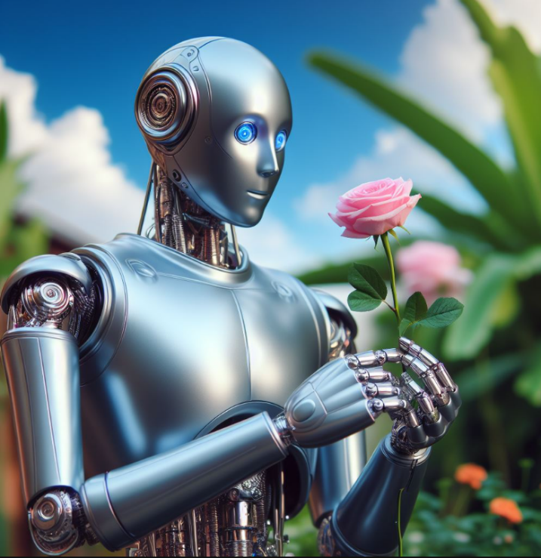
AI generated image
In-text display:
Figure 1
Robot Holding a Flower
Note. The image was generated by Midjourney (Midjourney, 2023) with the prompt “Robot holding a flower.“
Reference
Midjourney. (2023). Midjourney (V5) [Text-to-image model]. https://www.midjourney.com/
APA (2020)

Slide 81
Grammar Usage

Slide 82
Pronouns
The pronoun “they” or “their” is now acceptable to be used as a gender neutral singular pronoun when referring to an unknown person.
Example:
When a student is ready to register for classes, they must first attain a personal identification number (PIN) from their advisor.
APA (2020)

Slide 83
Verb Tense
Paper section | Recommended tense | Example
Literature review (or whenever discussing other researchers’ work) | Past | Williams (2020) addressed
 | Present perfect | Researchers have studied
Method Description of procedure | Past | Participants took a survey
 | Present perfect | Others have used similar approaches
Reporting of your own or other researchers’ results | Past | Results showed Scores decreased Hypotheses were not supported
Personal reactions | Past | I felt surprised
 | Present perfect | I have experienced
 | Present | I believe
Discussion of implications of results or of previous statements | Present | The results indicate The findings mean that
Presentation of study conclusions, limitations, and future directions | Present | We conclude Limitations of the study are Future research should explore
APA (2020)

Slide 84
Age Ranges and
Descriptive Phrases
  Use specific age ranges rather then open-ended descriptions when possible.
    Instead of the word teenagers, write individuals ages 12-18
  Use descriptive phrases rather than adjectives as nouns when discussing people.
    Instead of Chinese people write the people of China
APA (2020)

Slide 85
First Person Pronouns
Use first-person pronouns in APA style to describe your work as well as your personal reactions.
  If you are writing a paper by yourself, use the pronoun “I” to refer to yourself.
  If you are writing a paper with coauthors, use the pronoun “we” to refer yourself and your coauthors together.
APA (2020)

Slide 86
Mechanics

Slide 87
Commas and Semicolons
Use a serial comma (also called an Oxford comma, Harvard comma, or series comma) between elements in a series of three or more items.
  Factors of personality include extraversion, conscientiousness, openness to experience, agreeableness, and neuroticism.
If one or more items in the series already contain a comma, use semicolons between the items instead of commas.
  Subjective well-being is characterized by the presence of positive affect, such as whether people feel happy and peaceful; the absence of negative affect, such as whether people feel angry or bored; and a high level of life satisfaction.
APA (2020)

Slide 88
Numbers

Slide 89
Numbers Expresses As Words
In general, use words to express numbers zero through nine, and use numerals to express numbers 10 and above.
  there were five nurses on duty
  the study had three conditions
  students were in the third, sixth, eighth, 10th, and 12th grades
APA (2020)

Slide 90
Numbers Expresses As Words
Case | Example
Numbers that begin a sentence, title, or heading (when possible, reword the sentence to avoid beginning with a number) | Fifty percent of the students received the intervention, and the other 50% were part of a control condition. Twenty people enrolled in the class, but 15 dropped out.
Common fractions | one fifth of the class two-thirds majority
Certain universally accepted phrases | Twelve Apostles Five Pillars of Islam
APA (2020)

Slide 91
Numbers Expresses As Numerals
In general, use numerals to express numbers 10 and above, and use words to express numbers zero through nine.
  there were 15 psychologists at the clinic
  the study had 40 participants
  students were in the third, sixth, eighth, 10th, and 12th grades
APA (2020)

Slide 92
Numbers Expresses As Numerals
Case | Example
Numbers that immediately precede a unit of measurement | 5-mg dose 3 cm
Statistical or mathematical functions | multiplied by 2
Fractions or decimals (except common fractions) | 1.5 2.27
Percentages | 50% 75%–80%
APA (2020)

Slide 93
Abbreviations

Slide 94
Defining Abbreviations
Most abbreviations must be defined (explained) in an APA Style paper upon first use. However, it is also important to consider overall level of use of abbreviations in a paper to ensure you are using neither too many nor too few abbreviations.
Example:
Some Americans who suffer from attention deficit disorder (ADD) are not diagnosed as children.
  Note:
  Never begin a sentence with an abbreviation. Write out the full words.
APA (2020)

Slide 95
Abbreviations Within Parentheses
When the full version of a term first appears in parenthetical text, place the abbreviation in square brackets after it. Do not use nested parentheses.
  Example:
  (i.e., posttraumatic stress disorder [PTSD])
If a citation accompanies an abbreviation, include the citation after the abbreviation, separated with a semicolon. Do not use nested or back-to-back parentheses.
Example:
Parenthetical format: (Clinician-Administered PTSD Scale for DSM-5 [CAPS-5]; Weathers et al., 2018)
Narrative format: Clinician-Administered PTSD Scale for DSM-5 (CAPS-5; Weathers et al., 2018)
APA (2020)

Slide 96
Capitalization

Slide 97
Capitalization Chart
Capitalize | Do not capitalize
University of Florida | a university
Science of Nursing Practice | a nursing course
Department of Psychology, Department of English | a psychology department, an English department
Prozac, Humalog | fluoxetine, insulin lispro
President Washington | president, vice president, chief executive officer, executive director, manager
Dr. Iyengar | psychologist, psychiatrist, counselor, social worker
Dr. Kellogg | physician, doctor
Nurse Freeman | nurse, registered nurse, advanced practice nurse, nurse practitioner, physician assistant
APA (2020)

Slide 98
References
American Psychological Association. (2020). APA style. https://apastyle.apa.
org/
Quinn, S., Brown, L., Coleman, C., Edahl, C., & Grulick, C. (Eds.). (2020). Reading &
writing handbook for the college student (2nd ed.). Hawkes Learning/Quant
Systems.

