Slide 1

Managing References and Citations with Zotero
Library Cyber & Audio-Visual Section (E-Resources Browsing Area)
Date: Thursday, October 23, 2025

Slide 2
What is Referencing?
Referencing is the process of acknowledging the sources of information, ideas, or data that you use in your academic writing or research work. It shows where your information comes from and gives credit to the original authors.
Examples:
Baker-Gardner, R., Kerr, P. A., Marshall, J. L., Palmer, N. A., & Drysdale, D. A. (Eds.). (2024). The Role of Academic Libraries in Academic Integrity Development in Caribbean Higher Education Institutions. In Continuing Change, Constant Engagement: Caribbean Academic Libraries at the Forefront of Transformation (Vol. 57, p. 0). Emerald Publishing Limited. https://doi.org/10.1108/S0065-283020250000057009
Fernando, Y., & Li, Y. (2025). Responsible AI usage for academic integrity in China. Foresight. https://doi.org/10.1108/FS-05-2024-0095

Slide 3
Why You Need to Use References in Academic Writing?
Using references in academic writing is essential because they:
  Acknowledge sources: Give proper credit to the original authors for their ideas and research.
  Avoid plagiarism: Show that your work is honest and ethically produced.
  Support your arguments: Strengthen your writing with evidence from reliable sources.
  Show research depth: Demonstrate that you have read and understood relevant academic materials.
  Help readers verify information: Allow others to locate and review the sources you used.

Slide 4
Where You Need to Add References?
You should add references in your academic writing whenever you use information that comes from another source. This includes:
Quoting: When you use someone else’s exact words.
Paraphrasing: When you rephrase another author’s ideas in your own words.
Summarizing: When you condense another writer’s main points.
Using data or statistics: When you include research findings, figures, or survey results.
Using theories or models: When your work is based on established academic concepts.

Slide 5
Parts of Referencing
A complete reference usually has three main parts:
Author – The person or organization responsible for the work.
Example: Smith, J.
Date – The year (and sometimes month/day) when the work was published.
Example: (2022).
Title and Source – The title of the work and where it can be found (e.g., journal name, book title, publisher, or website).
Example: Library Management in the Digital Age. Springer.
Full Example:
Smith, J. (2022). Library Management in the Digital Age. Springer.

Slide 6
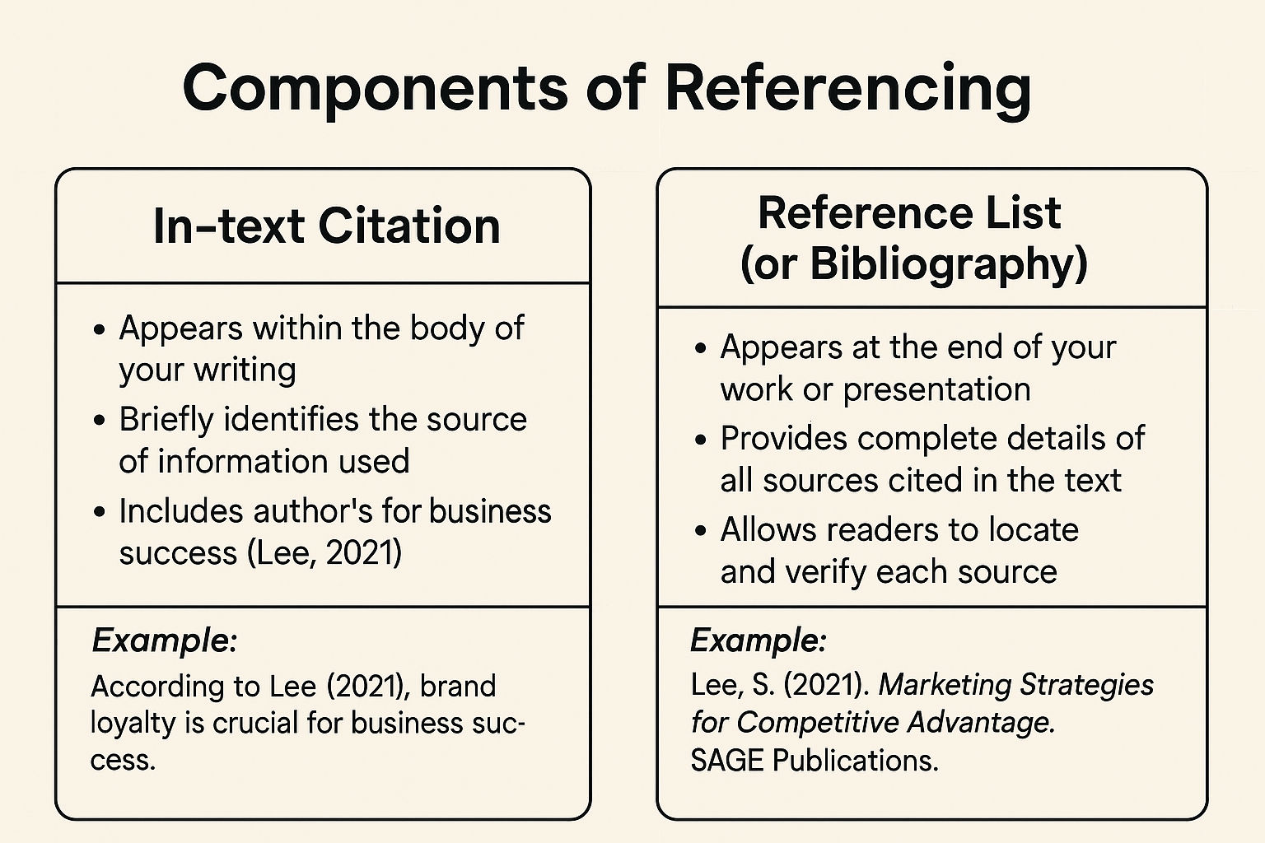

Slide 7
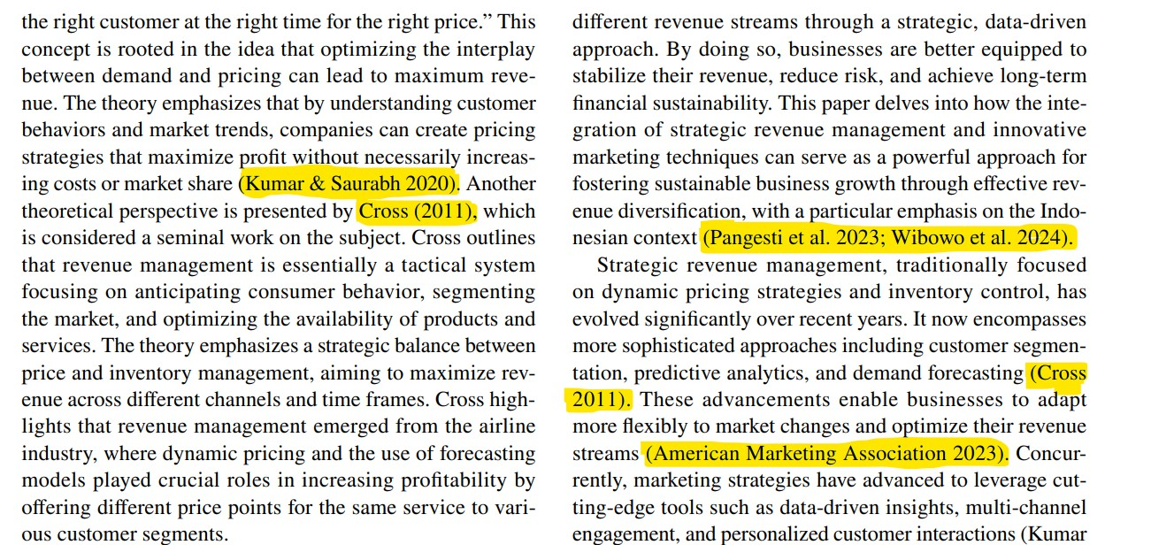
In-text citation (Example)

Slide 8
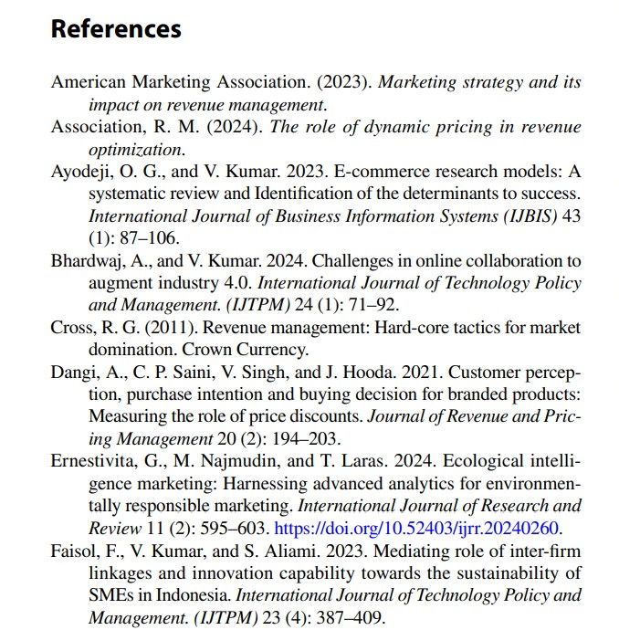
Reference List

Slide 9
Different Types of Referencing / Citation Styles
APA Style (American Psychological Association Used in: Social Sciences, Education, Psychology, Business In-text citation example: (Smith, 2022) Reference list example: Smith, J. (2022). Marketing management in the digital era. McGraw-Hill. | MLA Style (Modern Language Association) Used in: Literature, Arts, Humanities In-text citation example: (Smith 22) Works Cited example: Smith, John. Marketing Management in the Digital Era. McGraw-Hill, 2022.
Harvard Style Used in: Business, Management, and Social Sciences In-text citation example: (Smith, 2022) Reference list example: Smith, J. (2022) Marketing Management in the Digital Era. McGraw-Hill. | IEEE Style (Institute of Electrical and Electronics Engineers) Used in: Engineering, Computer Science, Technology In-text citation example: [1] Reference list example: [1] J. Smith, Marketing Management in the Digital Era, McGraw-Hill, 2022.
Chicago Style Used in: History, Fine Arts, and some Humanities Two systems: Notes-Bibliography and Author-Date Example (Author-Date): (Smith 2022, 45) Bibliography example: Smith, John. Marketing Management in the Digital Era. Chicago University Press, 2022. | Vancouver Style Used in: Medicine and Health Sciences In-text citation example: [1] Reference list example: 1. Smith J. Marketing management in the digital era. New York: McGraw-Hill; 2022.

Slide 10
What is Zotero?
Zotero is a free and open-source reference management tool that helps students, researchers, and academics collect, organize, cite, and share research materials. It allows users to save bibliographic information, PDFs, and web pages directly from their browser and generate citations in multiple styles (e.g., APA, MLA, Harvard).
Key Features:
Reference Collection: Save articles, books, and web pages with one click.
Organization: Create folders or tags to manage different research topics.
Citation & Bibliography: Insert citations and automatically generate bibliographies in Word, or LibreOffice.
Collaboration: Share research libraries with others using group libraries.
Cloud Syncing: Access your research data across multiple devices.

Slide 11
