Slide 1
Academic Integrity and Avoiding Plagiarism
North South University Library
Thursday, 6 November 2025

Slide 2

What is Academic Integrity?
Academic Integrity is a commitment to six core values that ensure a fair and credible learning environment:
Honesty: Submitting your original work and properly acknowledging the ideas and contributions of others.
Trust: Building a reliable and dependable environment for learning, teaching, and scholarship.
Fairness: Maintaining equitable and transparent standards, practices, and assessments for everyone.
Respect: Valuing the diversity of opinions and honoring the intellectual contributions of all members of the community.
Responsibility: Taking full ownership of your learning, actions, and the results that follow.
Courage: The strength to uphold these principles and do the right thing, even in the face of pressure or difficulty.

Slide 3

Violations of Academic Integrity
Breaches of Integrity
Academic integrity violations include, but are not limited to:
Plagiarism: Presenting others' words, ideas, or work as your own (The focus of the rest of this presentation).
Cheating: Unauthorized use of materials or information during an exam or assignment.
Fabrication: Falsifying or inventing data, information, or sources.
Facilitating Academic Dishonesty: Helping another student cheat or plagiarize.
Misrepresentation & Abuse of Technology: Improperly using technology or generative AI tools to complete academic work without explicit permission or direction from the instructor.

Slide 4

What Is Plagiarism?
Plagiarism is
“the act of presenting the words, ideas, images, sounds, or the creative expression of others as your own.”

Slide 5
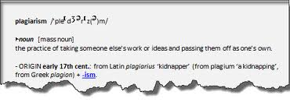
What's the origin of the word plagiarism?
The word plagiarism is derived from the Latin word plagiare, which means to kidnap or abduct

Slide 6

Why is it important to understand Plagiarism?
Plagiarism is stealing of intellectual property
Plagiarism is cheating
Plagiarism is an Academic offence
Plagiarism is Academic theft!

Slide 7

Excuses!
Why do students plagiarize?
It’s okay if
I don’t get caught!
Everyone does it!
This assignment
was BORING!
I was too busy to
write that paper!
(Job, big game, too much homework!)
My teachers
expect
too much!
My parents
expect “A”s!
Taken from Plagiarism PowerPoint at boe.qacps.k12.md.us/qhs/teachers/Boones/plagiarism.ppt

Slide 8
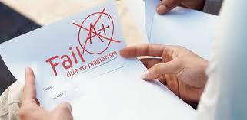
More Critical Reasons Why Students Plagiarize are :
Unaware of what constitute plagiarism
Do not understand why sources are so important
Do not know how to integrate/incorporate source materials into their own arguments or assignment
Have poor time-management skills, running out of time. Hence, they have no choice but to plagiarise.

Slide 9
Two Types of Plagiarism
Intentional Plagiarism
*Copying a friend’s work
* Borrowing or buying
assignments
* Cut and paste from
electronic resources
* Downloading essays from
the Internet and
presenting as your own
work
Unintentional Plagiarism
* Not knowing how to
acknowledge or
incorporate sources of
information through
proper paraphrasing,
summarising and
quotation
*Careless copying, cutting
and pasting from
electronic databases
*Quoting excessively
* Failure to use your own “voice”

Slide 10
Be Aware of What Constitutes Plagiarism and
Take Precaution
Both intentional or unintentional plagiarism are not acceptable and are academic offences
It is IMPORTANT that you acknowledge or give credit where it is due

Slide 11
Be Aware of What Constitutes Plagiarism and
Take Precaution
It does not matter whether the person whose work you have cited is alive or dead. You still have to cite if it is not your own idea
If you paraphrase or translate some sections of a piece of work, you must give a citation
If you take an image from the Internet or any source, you must cite the source

Slide 12
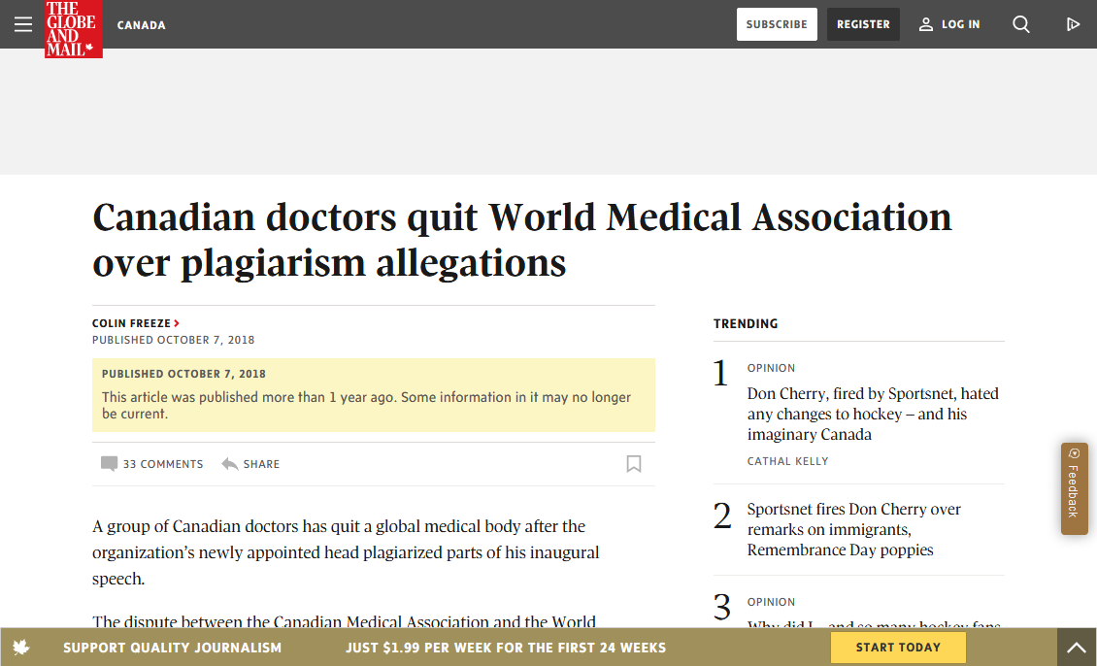
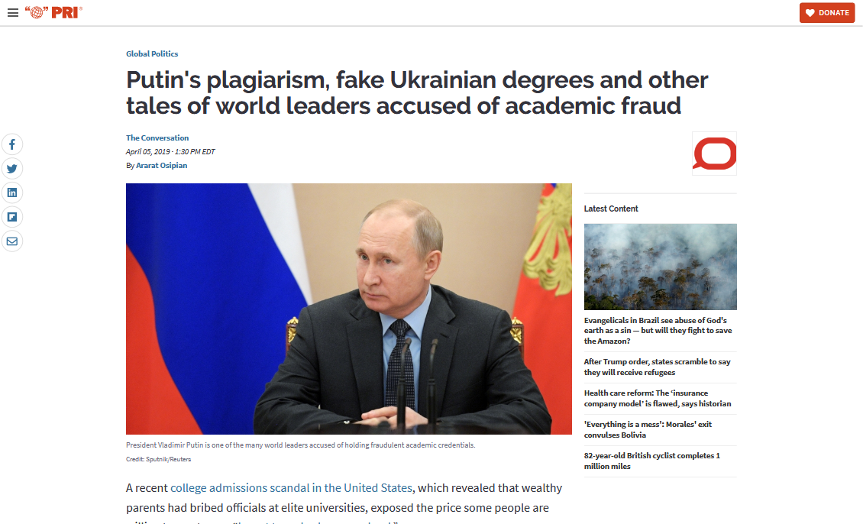
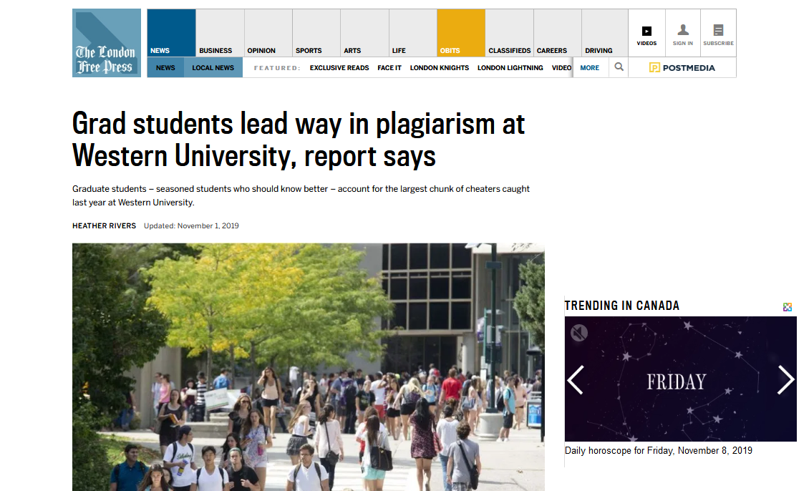
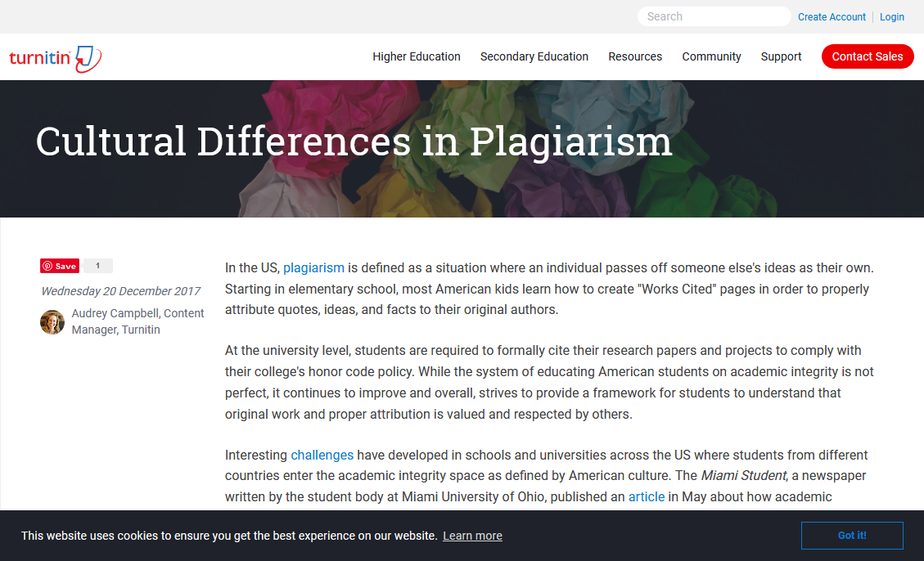
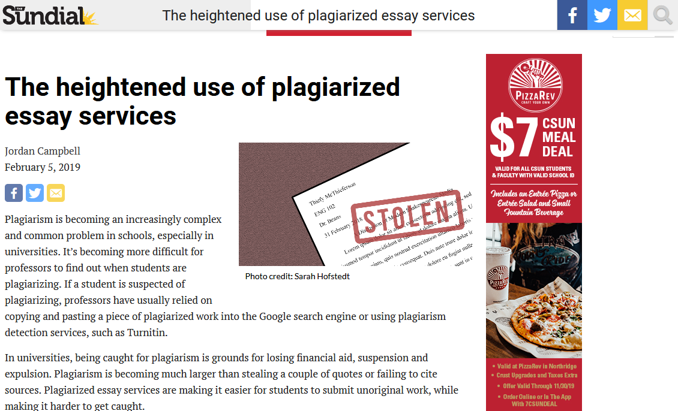
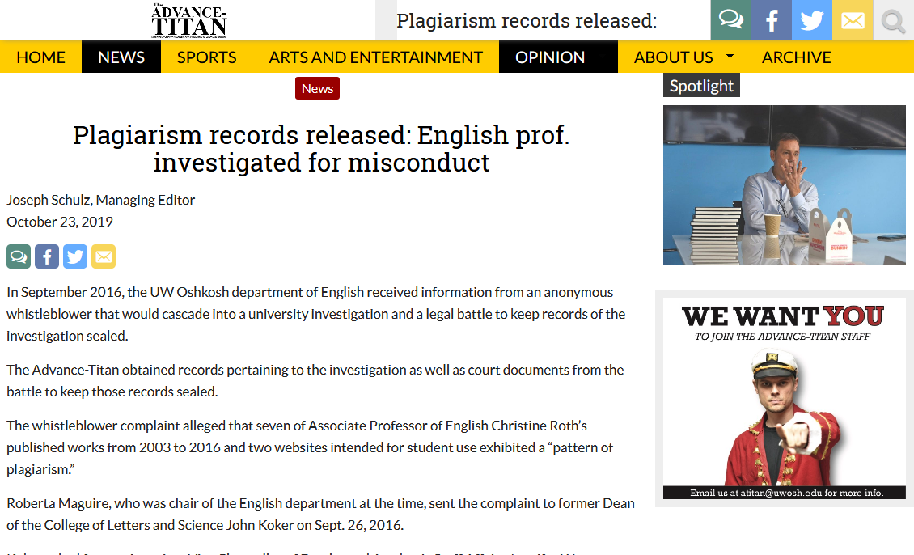
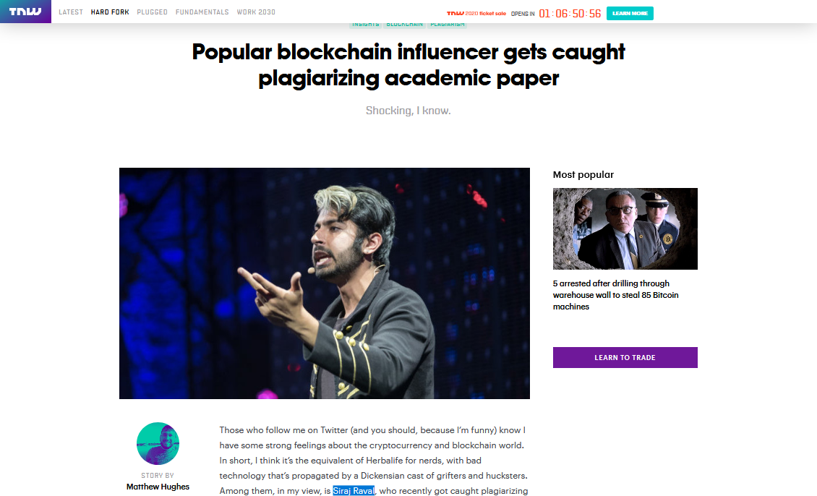
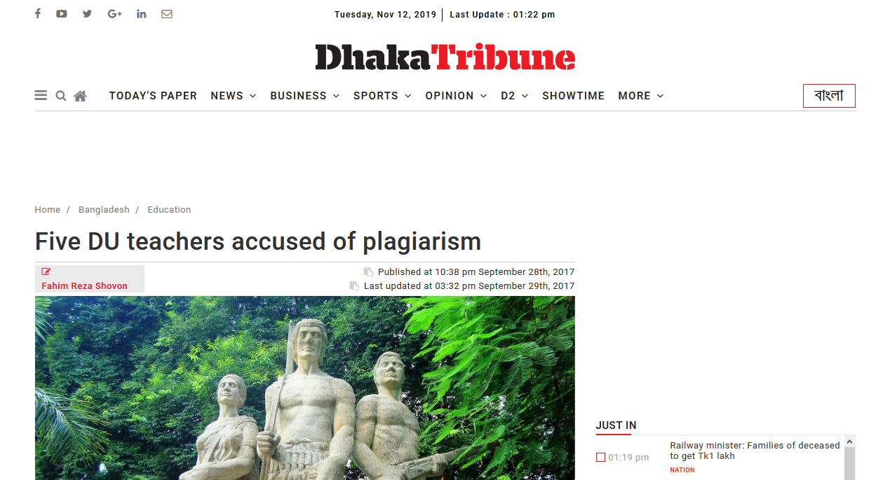
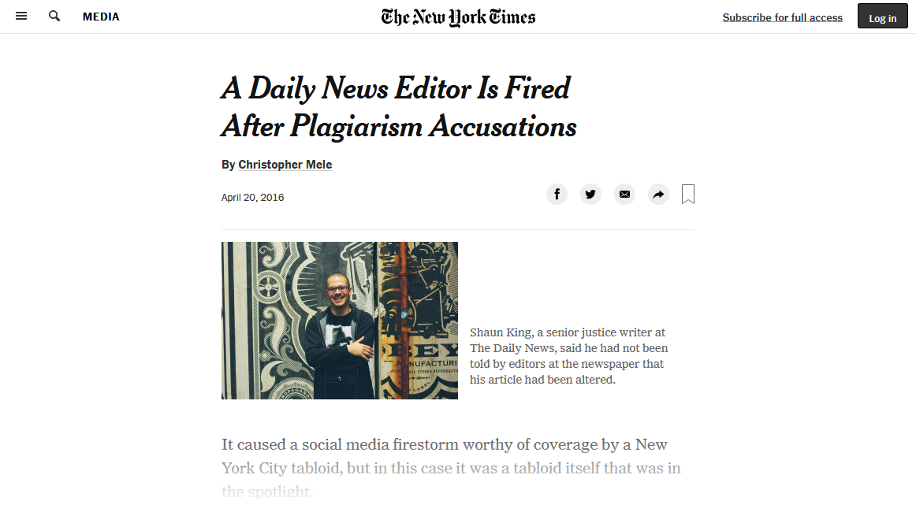
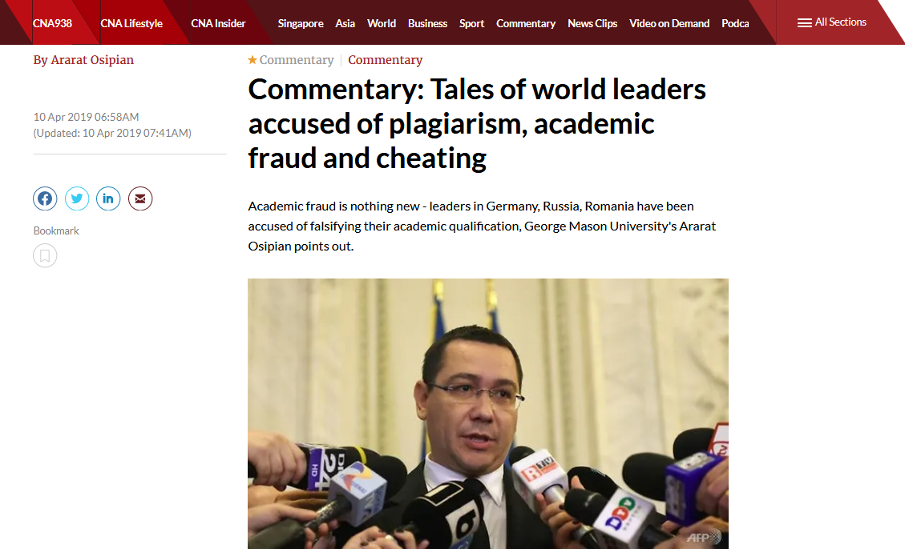
Real Life Consequences

Slide 13
NSU Policy: Penalty on Plagiarism
Any means of unauthorized assistance in preparing materials which a student submits as original work is deemed to be cheating and constitutes grounds for disciplinary action. Instructors are expected to use reasonably practical means of preventing and detecting cheating. Any student judged to have engaged in cheating might receive a reduced grade for the work in question, a failing grade in the course, or such other lesser penalty, as the instructor deems appropriate. Serious instances may be referred to the Disciplinary Committee in the Office of the Vice Chancellor.

Slide 14

Do I have
to cite
everything?
Taken from Plagiarism PowerPoint at boe.qacps.k12.md.us/qhs/teachers/Boones/plagiarism.ppt‎

Slide 15

Nope!
Facts that are widely known, or
Information or judgments considered “common knowledge”
Do NOT have to be cited
Hooray for
common
knowledge!
-- taken from Joyce Brannon’s “Plagiarism.” PowerPoint Presentation & Joyce Valenza’s “What is Plagiarism?” (See works cited). (Internet downloads) boe.qacps.k12.md.us/qhs/teachers/Boones/plagiarism.ppt‎

Slide 16
Examples of Common Knowledge or
Widely Accepted Facts
The Nile is the longest river in the world
The world is round
The sun rises in the east
Dhaka is the capital city of Bangladesh
If you see the information in three or more sources, and you are quite sure that your readers already know this information, it is likely to be “common knowledge.”
However, whenever you are in doubt, cite!

Slide 17
You do not need to document/cite when:
Writing your own experiences and observations
Presenting the results of original research or experiments
Writing your own thoughts, comments or conclusions in an assignment
Evaluating or offering your own analysis
Using common knowledge or folklore
Using generally accepted facts or information

Slide 18


What’s the big deal?
Wrong! Paraphrasing
original ideas without
documenting
your source,
is plagiarism too!
If I change a
few words, I’m okay, right?
-- taken from Joyce Brannon’s “Plagiarism.” PowerPoint Presentation & Joyce Valenza’s “What is Plagiarism?” (See works cited). (Internet downloads) boe.qacps.k12.md.us/qhs/teachers/Boones/plagiarism.ppt‎

Slide 19
You can “borrow” from the works of others to be used in your own work!
BUT HOW?

Slide 20
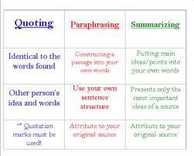
Use these 3 Strategies
Quotation
Paraphrasing
Summarizing
This is to help you blend/incorporate source materials into your own writing and make sure that your “voice” is heard

Slide 21
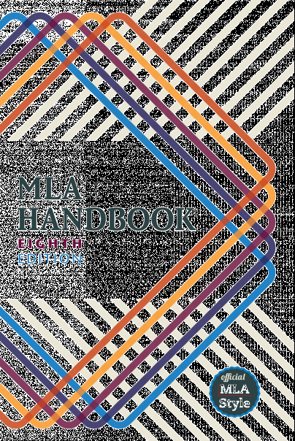
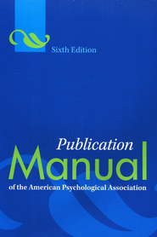
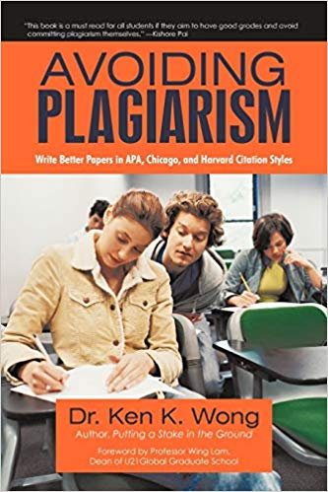
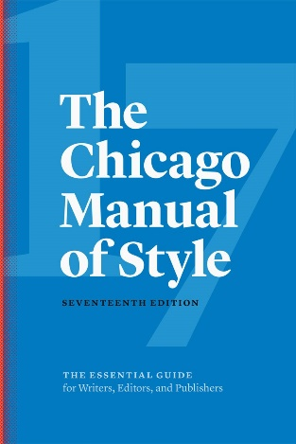
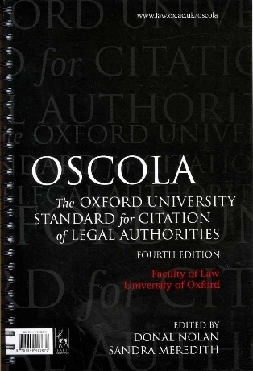
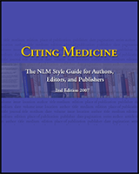
Quotations
Use quotations to support your arguments and add credibility to your research paper.

Slide 22
Tips for Using Quotations
Students frequently overuse
direct quotation
Only about 10% of
your final manuscript
should appear as directly
quoted matter

Slide 23
Example
Interpreting these results, Robbins et al. (2003) suggested that the “therapists in dropout cases may have inadvertently validated parental negatively about the adolescent without adequately responding to the adolescent’s needs or concerns” (p. 541), contributing to an overall climate of negativity.

Slide 24
For Quotations
1. Must be identical to the original. Match the source document word for word
2. Put quotation marks around the original author’s exact words
3. Must reference the original source
4. Include the page number of the original source

Slide 25
Paraphrasing vs Summarizing
Feature | Paraphrasing | Summarizing
Purpose | To restate a specific section (a sentence or short paragraph) in your own words. | To condense the main ideas of a larger text (an article, chapter, or book) into a brief overview.
Scope | Specific detail; focuses on a single point, claim, or piece of evidence. | Broad overview; focuses on the argument, thesis, and major conclusions.
Length | Generally about the same length as the original source material, or slightly shorter. | Significantly shorter than the original source material.
Detail | Includes all the important details and nuances of the original passage, just using new wording and sentence structure. | Omits specific examples, evidence, illustrations, and non-essential details.
When to Use | When you need the full detail of an author's specific point, or to clarify a complex passage. | When you need to provide background context or establish the main argument of a source.

Slide 26
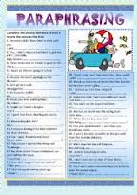
Paraphrasing
Presenting someone else’s essential ideas and information in your own words or language

Slide 27
Example
Original source: Lizzie Borden: A Case Book of Family and Crime in the 1890s by Joyce Williams, et al.:
The rise of industry, the growth of cities, and the expansion of the population were the three great developments of late nineteenth century American history. As new, larger, steam-powered factories became a feature of the American landscape in the East, they transformed farm hands into industrial laborers, and provided jobs for a rising tide of immigrants. With industry came urbanization the growth of large cities (like Fall River, Massachusetts, where the Bordens lived) which became the centers of production as well as of commerce and trade.

Slide 28
After Paraphrasing
Fall River, where the Borden family lived, was typical of northeastern industrial cities of the nineteenth century. Steam-powered production had shifted labor from agriculture to manufacturing, and as immigrants arrived in the US, they found work in these new factories. As a result, populations grew, and large urban areas arose. Fall River was one of these manufacturing and commercial centers (Williams, 1890).

Slide 29
For Paraphrasing
The paraphrased material is usually the same length or slightly shorter than the original passage
Must use your own words
3. Must reference the original source

Slide 30

Summarizing
The author’s original words are rewritten into a substantially shortened form that captures the most important elements

Slide 31
Example
Original source:
"For the semantic web to function, computers must have access to structured collections of information and sets of inference rules that they can use to conduct automated reasoning. Artificial-intelligence researchers have studied such systems since long before the Web was developed. Knowledge representation, as this technology is often called, is currently in a state comparable to that of hypertext before the advent of the Web: it is clearly a good idea, and some very nice demonstrations exist, but it has not yet changed the world. It contains the seeds of important applications, but to realize its full potential it must be linked into a single global system."

Slide 32
After Summarizing
Berners-Lee et al (2001) argue that incorporating artificial intelligence techniques into the mechanisms of the Internet will result in new systems with potential to make a large impact on society.
References
Berners-Lee, T., Hendler, J. & Lassila, O. (2001, May). The semantic web. Scientific American,
35-43.

Slide 33
For Summarizing
1. The text is much shorter than the original text
2. Must use your own words, usually with very limited use of quotations
3. Must reference the original source

Slide 34
In-Text Citations
Whenever you paraphrase, summarise or quote from a particular source, you have to do “In-text Citation”
An In-text Citation is referencing a work in the body of the text.
It consist of the author’s surname and date of publication. To include page number if there is a direct quotation
For example:
A study conducted by Bright and Western (1984) suggested a significant relationship between...
Alternatively, when emphasizing a particular author's ideas, author name/s can become the subject of the sentence with the date only following in brackets.
For example:
Bright and Western (1984) have argued that...

Slide 35
Citation Styles
Popular citation styles:
APA Style, IEEE, Harvard Style, MLA,
Vancouver, NLM etc.
The Plagiarism Spectrum
https://www.turnitin.com/static/plagiarism-spectrum/
Turnitin Plagiarism Quiz
https://www.turnitin.com/static/plagiarism-quiz/

Slide 36


