Slide 1

Managing References and Citations with Mendeley
Library Cyber & Audio-Visual Section (E-Resources Browsing Area)
Date: Thursday, November 20, 2025

Slide 2
What is Referencing?
Referencing is the process of acknowledging the sources of information, ideas, or data that you use in your academic writing or research work. It shows where your information comes from and gives credit to the original authors.
Examples:
Baker-Gardner, R., Kerr, P. A., Marshall, J. L., Palmer, N. A., & Drysdale, D. A. (Eds.). (2024). The Role of Academic Libraries in Academic Integrity Development in Caribbean Higher Education Institutions. In Continuing Change, Constant Engagement: Caribbean Academic Libraries at the Forefront of Transformation (Vol. 57, p. 0). Emerald Publishing Limited. https://doi.org/10.1108/S0065-283020250000057009
Fernando, Y., & Li, Y. (2025). Responsible AI usage for academic integrity in China. Foresight. https://doi.org/10.1108/FS-05-2024-0095

Slide 3
Why You Need to Use References in Academic Writing?
Using references in academic writing is essential because they:
  Acknowledge sources: Give proper credit to the original authors for their ideas and research.
  Avoid plagiarism: Show that your work is honest and ethically produced.
  Support your arguments: Strengthen your writing with evidence from reliable sources.
  Show research depth: Demonstrate that you have read and understood relevant academic materials.
  Help readers verify information: Allow others to locate and review the sources you used.

Slide 4
Where You Need to Add References?
You should add references in your academic writing whenever you use information that comes from another source. This includes:
Quoting: When you use someone else’s exact words.
Paraphrasing: When you rephrase another author’s ideas in your own words.
Summarizing: When you condense another writer’s main points.
Using data or statistics: When you include research findings, figures, or survey results.
Using theories or models: When your work is based on established academic concepts.

Slide 5
Parts of Referencing
A complete reference usually has three main parts:
Author – The person or organization responsible for the work.
Example: Smith, J.
Date – The year (and sometimes month/day) when the work was published.
Example: (2022).
Title and Source – The title of the work and where it can be found (e.g., journal name, book title, publisher, or website).
Example: Library Management in the Digital Age. Springer.
Full Example:
Smith, J. (2022). Library Management in the Digital Age. Springer.

Slide 6
Author
Publication Year
Publication Title
Hu, Q., Xu, Q., Wu, J., & Zhang, L. (2025). Neural network prediction model of digital marketing under the green development mode of enterprises. Discover Computing, 28(1), 86. https://doi.org/10.1007/s10791-025-09568-4
Kotler, P., & Armstrong, G. M. (2010). Principles of Marketing. Pearson Education India.
Journal
Vol, Issue, Number
Source
Author
Publication Year
Book Title
Publisher

Slide 7
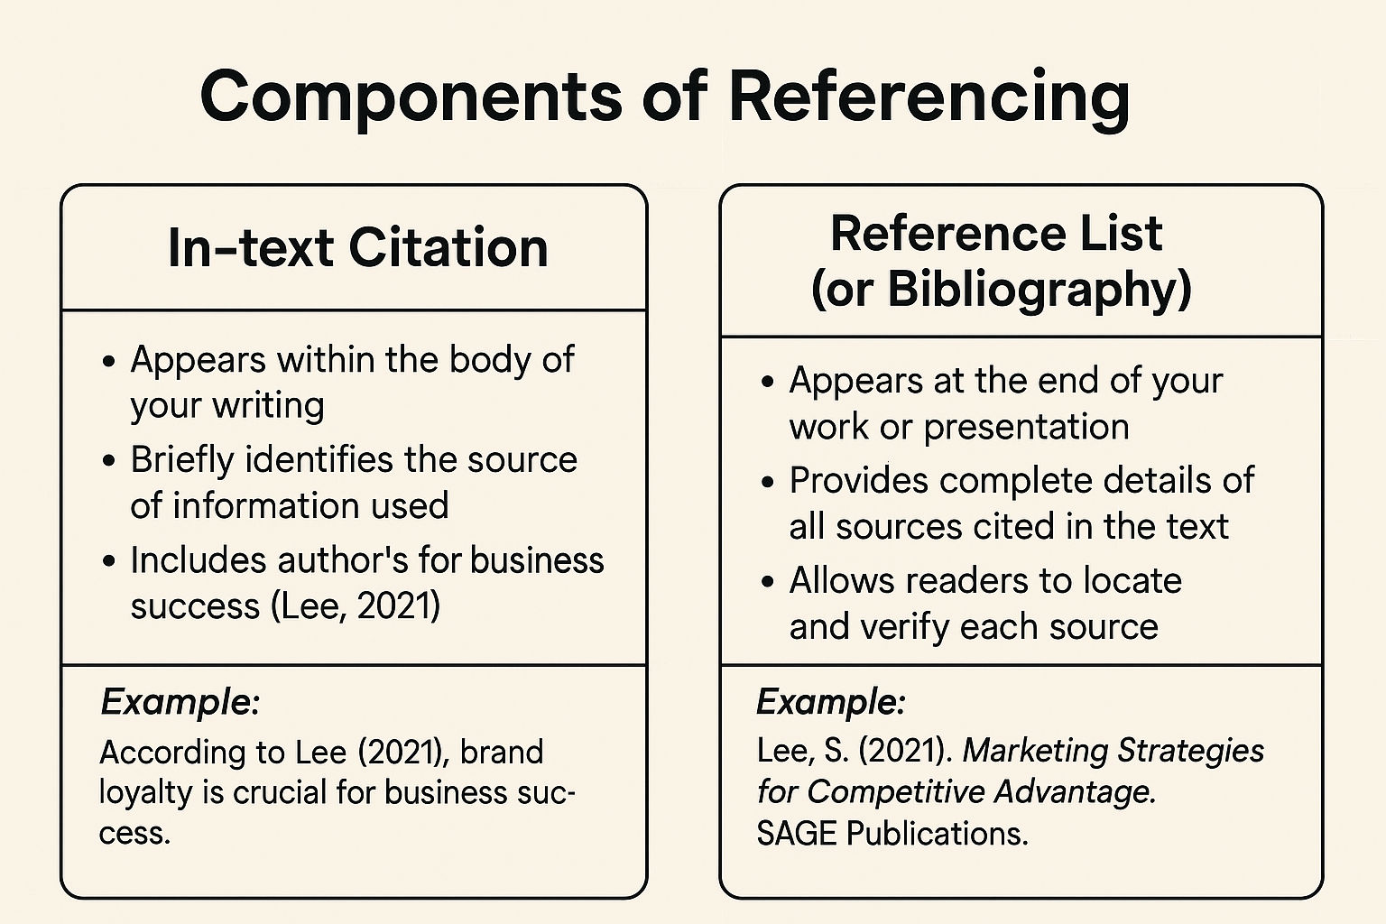

Slide 8
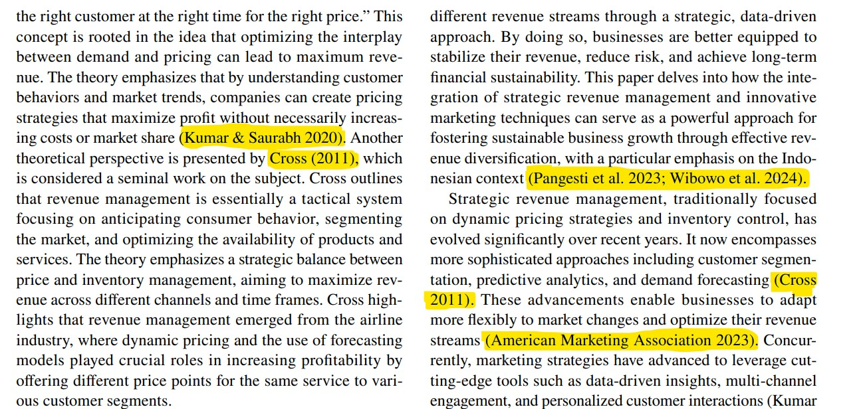
In-text citation (Example)

Slide 9
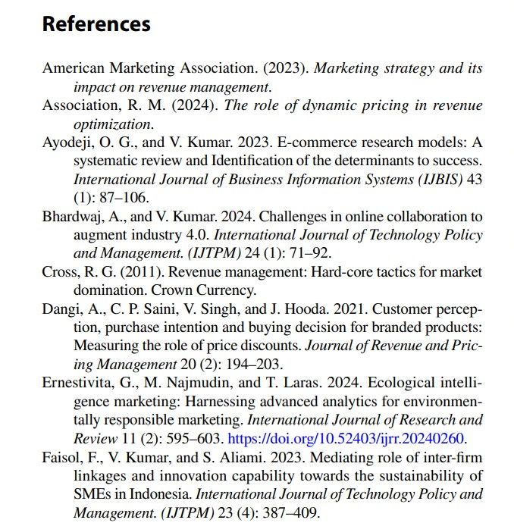
Reference List

Slide 10
Different Types of Referencing / Citation Styles
APA Style (American Psychological Association Used in: Social Sciences, Education, Psychology, Business In-text citation example: (Smith, 2022) Reference list example: Smith, J. (2022). Marketing management in the digital era. McGraw-Hill. | MLA Style (Modern Language Association) Used in: Literature, Arts, Humanities In-text citation example: (Smith 22) Works Cited example: Smith, John. Marketing Management in the Digital Era. McGraw-Hill, 2022.
Harvard Style Used in: Business, Management, and Social Sciences In-text citation example: (Smith, 2022) Reference list example: Smith, J. (2022) Marketing Management in the Digital Era. McGraw-Hill. | IEEE Style (Institute of Electrical and Electronics Engineers) Used in: Engineering, Computer Science, Technology In-text citation example: [1] Reference list example: [1] J. Smith, Marketing Management in the Digital Era, McGraw-Hill, 2022.
Chicago Style Used in: History, Fine Arts, and some Humanities Two systems: Notes-Bibliography and Author-Date Example (Author-Date): (Smith 2022, 45) Bibliography example: Smith, John. Marketing Management in the Digital Era. Chicago University Press, 2022. | Vancouver Style Used in: Medicine and Health Sciences In-text citation example: [1] Reference list example: 1. Smith J. Marketing management in the digital era. New York: McGraw-Hill; 2022.

Slide 11
Mendeley Reference Management Tool
Mendeley is a powerful reference management tool designed to help researchers collect, organize, and cite scholarly materials with ease. With the premium version, users benefit from expanded storage, advanced collaboration features, and enhanced PDF annotation tools. Premium users can create larger shared libraries, collaborate with more team members, and securely store extensive collections of research articles. The tool also supports seamless citation generation across multiple styles, integration with word processors, and synchronized access across devices.

Slide 12
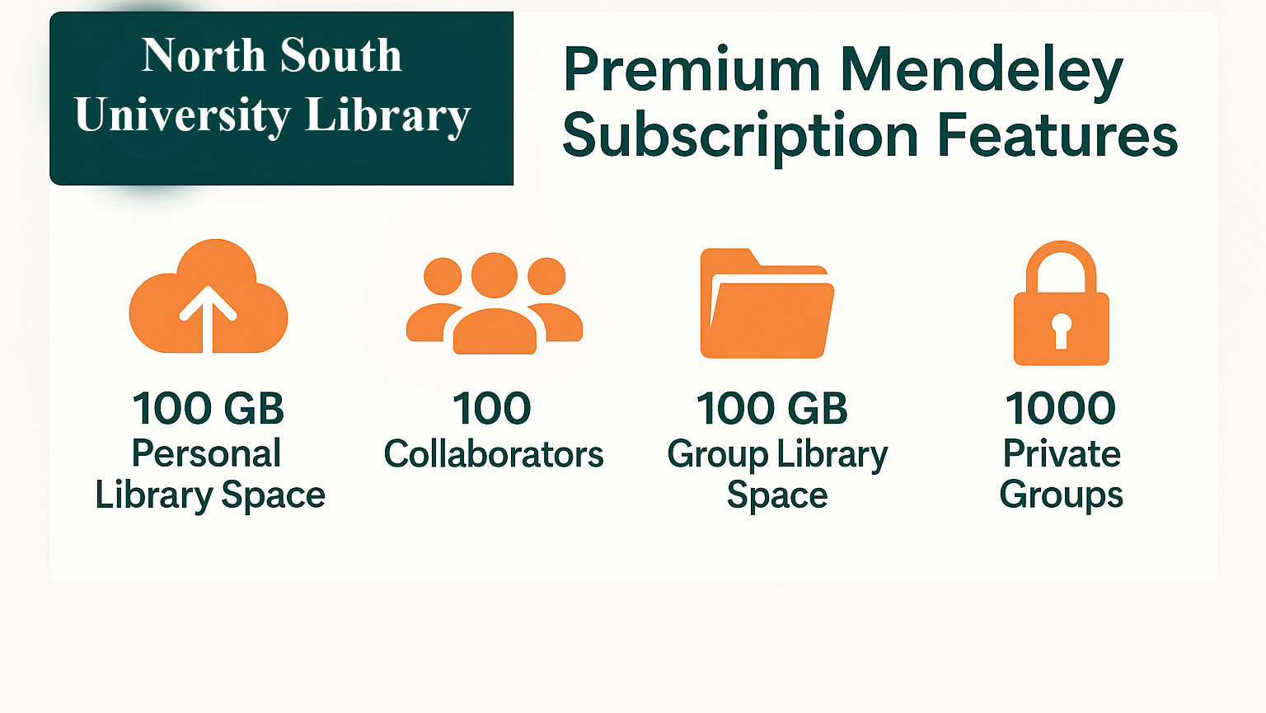

Slide 13
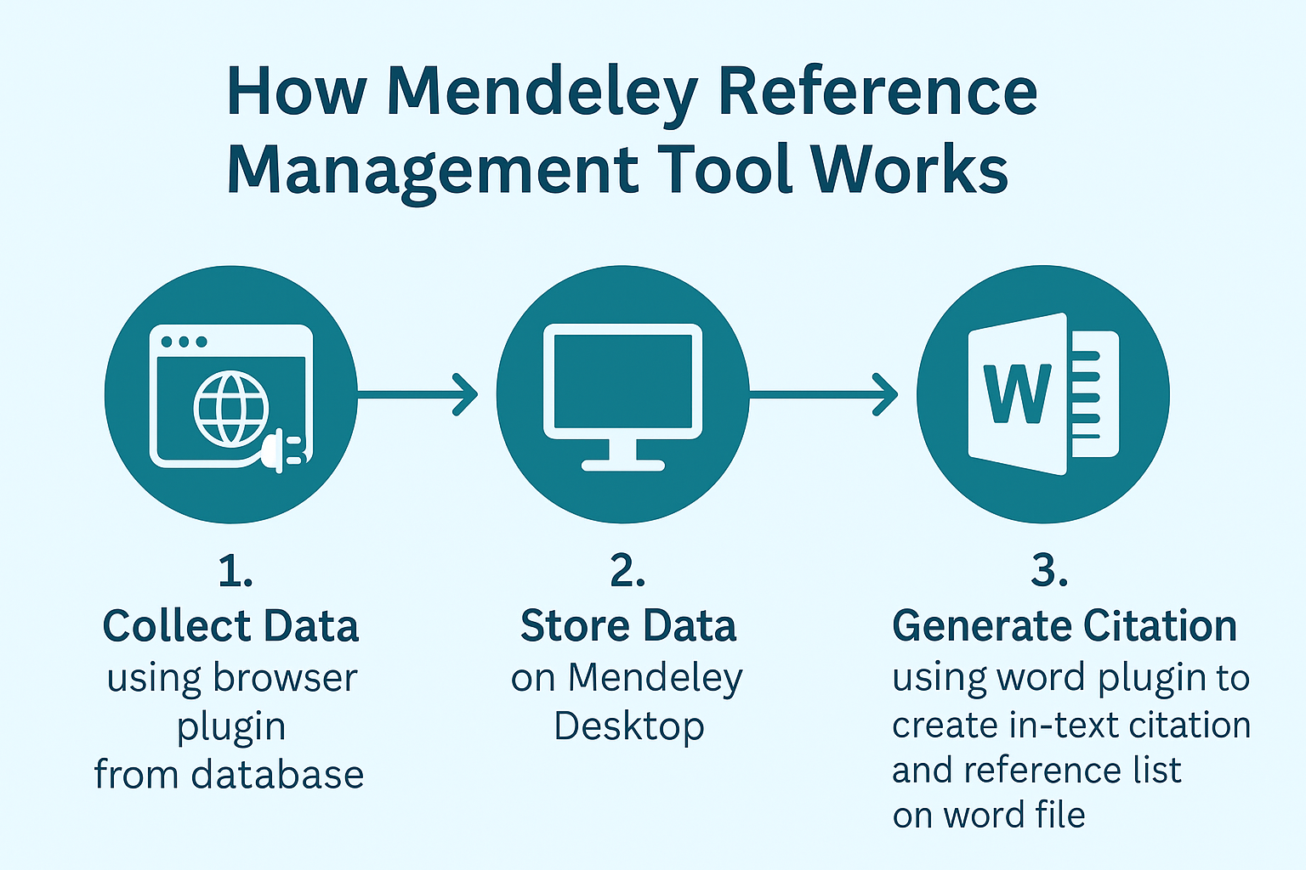

Slide 14
How to Activate Your Mendeley Premium Account
1. Open an Incognito/Private Window
Launch your browser
Switch to Incognito/Private mode
2. Visit the Mendeley Website
Go to: https://www.mendeley.com/
3. Create Your Account
Click “Create account”
Sign up using your NSU institutional email
4. Verify Your Email
Check your NSU inbox
Click the verification link
5. Enjoy Mendeley Premium
Log in and access all premium features provided by NSU Library

Slide 15
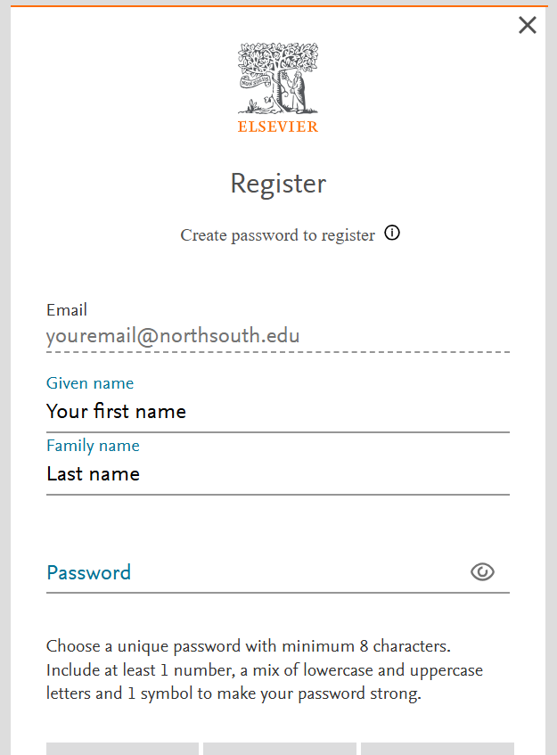
Registration

Slide 16
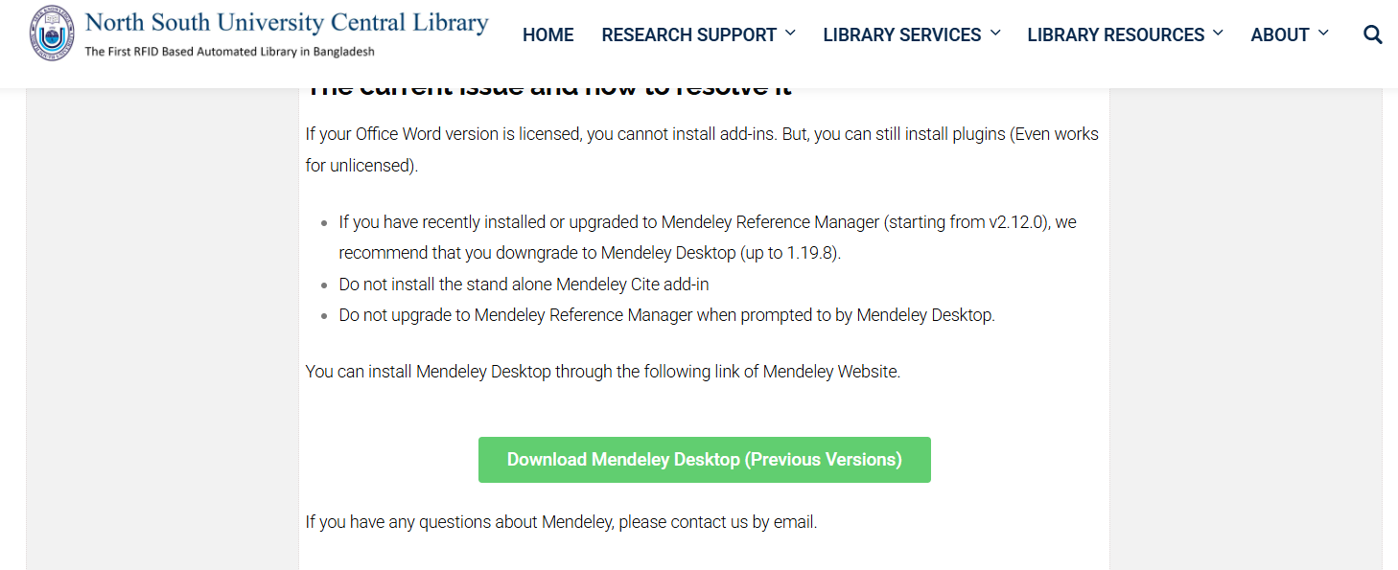
Download Mendeley Desktop
Visit: https://library.northsouth.edu/research-support/referencing-software/mendeley/

Slide 17
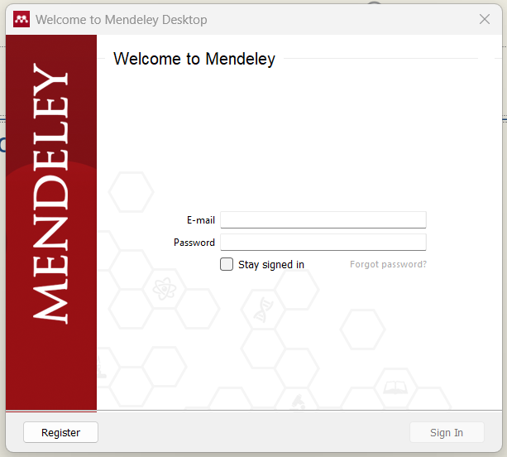
Mendeley Desktop Login

Slide 18
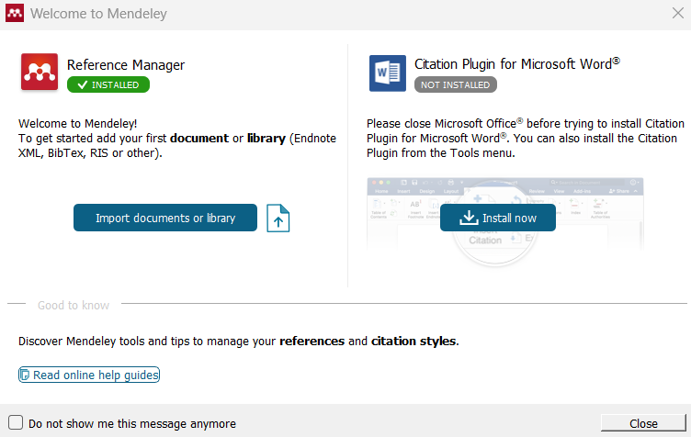
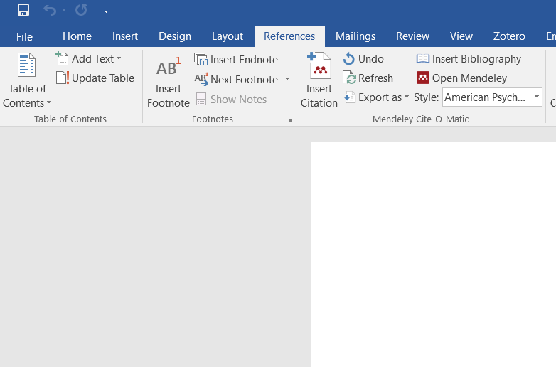
Mendeley Word Plugin
1. After logging in to the Mendeley Desktop app, a pop-up window will appear prompting you to install the MS Word plugin. Simply click “Install Now”, and the plugin will be automatically added to your Microsoft Word toolbar. If the pop-up does not appear or you want to install it manually, you can do so by navigating to Tools → Install MS Word Plugin within the Mendeley Desktop application. | 2. After opening Microsoft Word, navigate to the References tab, where you will find the Mendeley citation tools. From this toolbar, you can insert in-text citations, manage references, and generate your reference list directly within your document.

Slide 19
Add Mendeley Web Importer
To start collecting references easily, you need to install the Mendeley Web Importer for your browser. This tool allows you to import citation information directly from journal websites, web pages, eBook databases, and other online sources with a single click. You can add the Web Importer by selecting your browser:
Chrome : Click Here
Firefox : Click Here
Edge : Click Here
Safari : Click Here
You can also install it directly from the Mendeley Desktop application by navigating to Mendeley Desktop → Tools → Install Web Importer.
Once installed, the Web Importer makes capturing citation data quick and effortless.

